Slide 1
Karma: A Data Integration Tool
Information Integration Research Group
Information Sciences Institute, USC
Pedro Szekely, Craig Knoblock, Jose Luis Ambite, Mohsen Taheriyan, Jason Slepicka, Bo Wu, Dipsy Kapoor, and many students.

Slide 2
Outline
Introduction to data integration
Karma
Use cases
Demo

Slide 3
Data Integration Approaches

Slide 4

Data Integration Approaches
Data Warehousing

Slide 5
Data Integration Approaches
Data Warehousing
Virtual Integration

Slide 6
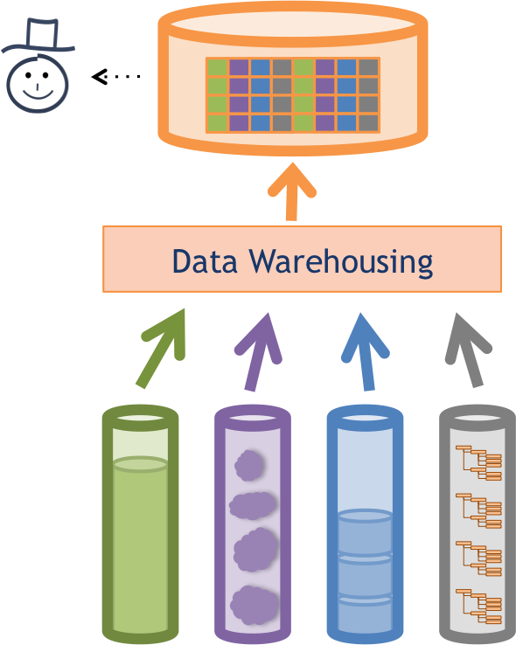
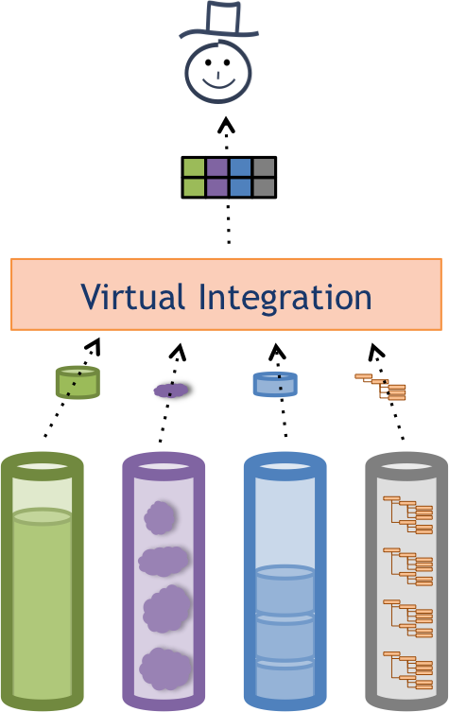
Domain Model
Describes the domain you have,
e.g., people, events and their attributes
Domain Model

Slide 7
Key Ingredient: Source Mappings
Domain Model
Describe how data in sources relate to the domain model
Source Mappings

Slide 8
Karma: A Data Integration Tool

Slide 9


Karma
Interactive tool for rapidly extracting, cleaning, transforming, integrating and publishing data
Tabular
Sources
RDF
Database
Hierarchical Sources
Karma
CSV
Services
…
http://www.isi.edu/integration/karma
@KarmaSemWeb

Slide 10


Information Integration in Karma
Karma
semi-automatically generates Source Mappings
Domain Model
Karma
Source Mappings
Samples of Source Data

Slide 11
Information Integration in Karma
Karma
semi-automatically generates Source Mappings
Domain Model
Karma
Source Mappings
Samples of Source Data
Karma
supports multiple integration regimes

Slide 12
Secret Sauce: Karma Understands Your Data
Semantic Model
of the Data
Domain Model
Karma
Source Mappings
Samples of Source Data
Karma semi-automatically builds a semantic model of your data

Slide 13
What is a Semantic Model?
Describe sources using classes & relationships in an ontology
Source
 | name | date | city | state | workplace
1 | Fred Collins | Oct 1959 | Seattle | WA | Microsoft
2 | Tina Peterson | May 1980 | New York | NY | Google
bornIn
nearby
birthdate
isPartOf
livesIn
Place
Person
name
organizer
location
postalCode
name
ceo
City
State
worksFor
Event
state
Organization
title
endDate
Domain
Model
object property
phone
data property
name
startDate
subClassOf

Slide 14
Semantic Types
Person
Person
City
State
Organization
name
birthdate
name
name
name
 | name | date | city | state | workplace
1 | Fred Collins | Oct 1959 | Seattle | WA | Microsoft
2 | Tina Peterson | May 1980 | New York | NY | Google

Slide 15
Relationships
worksFor
bornIn
state
Person
City
State
Organization
name
birthdate
name
name
name
 | name | date | city | state | workplace
1 | Fred Collins | Oct 1959 | Seattle | WA | Microsoft
2 | Tina Peterson | May 1980 | New York | NY | Google

Slide 16
Semantic Model
worksFor
bornIn
state
Person
City
State
Organization
name
birthdate
name
name
name
 | name | date | city | state | workplace
1 | Fred Collins | Oct 1959 | Seattle | WA | Microsoft
2 | Tina Peterson | May 1980 | New York | NY | Google
Semantic models will be formalized as Source Mappings
Key ingredient to automate source discovery, data integration, and publishing semantic data (RDF triples)

Slide 17
Semi-automatically Building Semantic Models in Karma

Slide 18


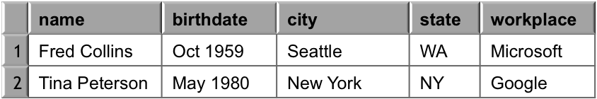
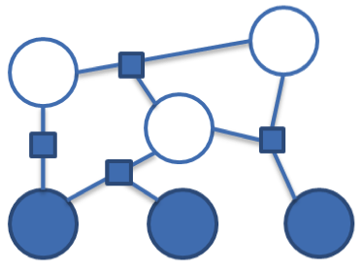
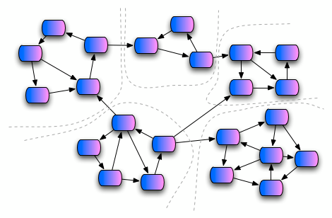

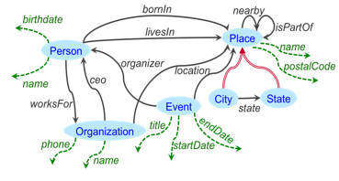
Approach [Knoblock et al, ESWC 2012]
Sample Data
Steiner Tree
Learn
Semantic Types
Extract
Relationships
Construct a Graph
Domain Ontology
[Craig A. Knoblock, Pedro Szekely, José Luis Ambite, Aman Goel, Shubham Gupta, Kristina Lerman, Maria Muslea, Mohsen Taheriyan, Parag Mallick. Semi-automatically Mapping Structured Sources into the Semantic Web. In: Simperl E., Cimiano P., Polleres A., Corcho O., Presutti V. (eds) The Semantic Web: Research and Applications. ESWC 2012. Lecture Notes in Computer Science, vol 7295. Springer, Berlin, Heidelberg]

Slide 19
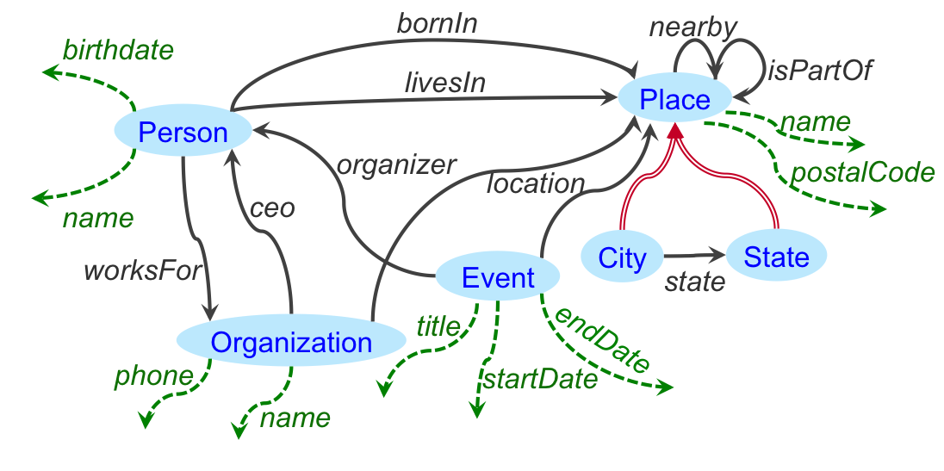
Example
Source
 | name | date | city | state | workplace
1 | Fred Collins | Oct 1959 | Seattle | WA | Microsoft
2 | Tina Peterson | May 1980 | New York | NY | Google
Domain Ontology
object property
data property
subClassOf
Find a semantic model for the source (map the source to the ontology)

Slide 20
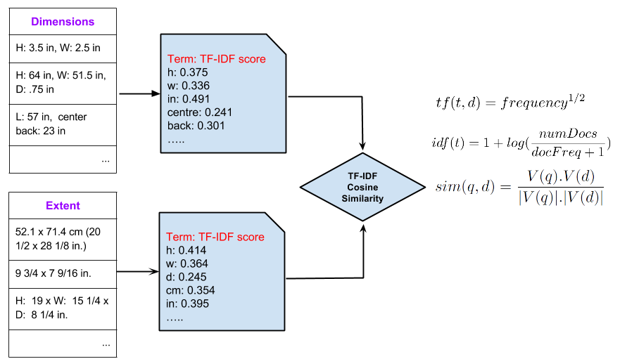
Learning Semantic Types [Krishnamurthy et al., ESWC 2015]
class?
property ?

Slide 21
Learning Semantic Types
CulturalHeritageObject
extent
1- User specifies
2- System learns

Slide 22
Learning Semantic Types
CulturalHeritageObject
extent

Slide 23
Learning Semantic Types
CulturalHeritageObject
CulturalHeritageObject
extent
extent

Slide 24
Requirements
Learn from a small number of examples
Work on both textual and numeric values
Learn quickly and highly scalable to large number of semantic types

Slide 25
Approach for Textual Data
Document: each column of data
Label: each semantic type
Use Apache Lucene to index the labeled documents
Compute TF/IDF vectors for documents
Compare documents using Cosine Similarity between TF/IDF vectors

Slide 26
Approach for Textual Data

Slide 27
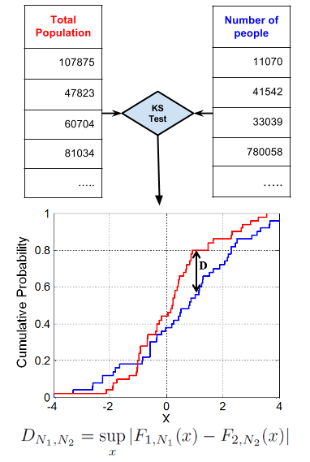
Approach for Numeric Data
Distribution of values in different semantic types is different, e.g., temperature vs. population
Use Statistical Hypothesis Testing to see which distribution fits best
Welch’s T-test, Mann-Whitney U-test and Kolmogorov-Smirnov Test

Slide 28
Approach for Numeric Data
Notes:
In inferential statistics the null hypothesis usually refers to a general statement or default position that there is no relationship between two measured phenomena, or no difference among groups.
Two-sample test checks whether the two data samples come from the same distribution.

Slide 29
Combined Approach
Training
Add new example data as training for either textual or numeric types
If ambiguous, train as both textual and numeric
Testing
If textual, apply tf/idf
If numeric apply KS-test
If ambiguous and at least 70% numeric apply KS-test, otherwise tf/idf
Return Top-k suggestions based on the confidence scores

Slide 30
Evaluation of Semantic Typing
Museum Dataset – 29 data sources from different art museums in the US.
Ontologies: EDM, AAC, FOAF, SKOS, Dublin Core Metadata Terms, ORE, ElementsGr2
City Dataset – 10 data sources about various cities in the world - manually extracted from Dbpedia.
Ontology: DBpedia Ontology

Slide 31
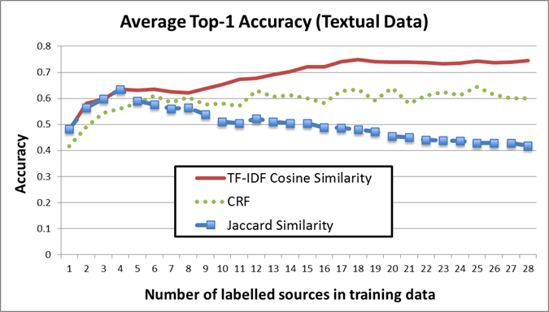
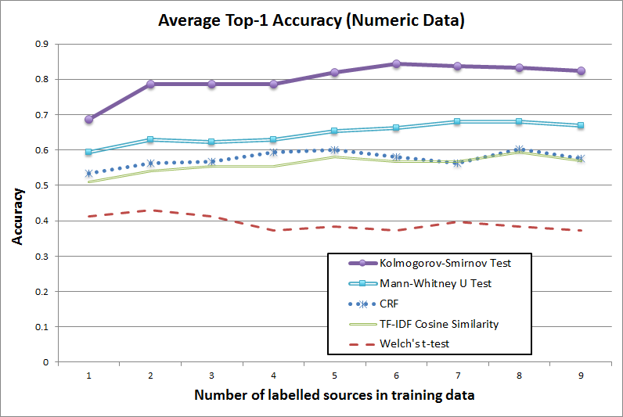
Evaluation of Semantic Typing
Combined approach
achieves 97% accuracy on the top-4 accuracy
Reduced the training time from 110s to 0.45s

Slide 32
Construct a Graph
Construct a graph from semantic types and ontology
Person
Person
City
State
Organization
name
birthdate
name
name
name
 | name | date | city | state | workplace
1 | Fred Collins | Oct 1959 | Seattle | WA | Microsoft
2 | Tina Peterson | May 1980 | New York | NY | Google

Slide 33
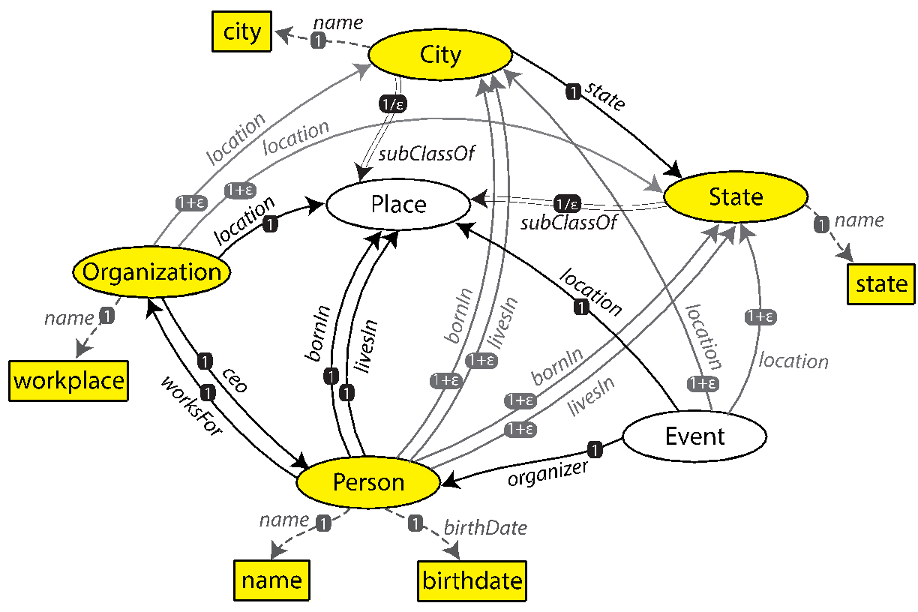
Construct a Graph
Construct a graph from semantic types and ontology
date

Slide 34
Inferring the Relationships
Search for minimal explanation
Steiner tree connecting semantic types over ontology graph
Given graph G=(V,E), nodes S ⊂ V, cost c: E →ℜ
Find a tree of G that spans S with minimal total cost
Unfortunately, NP-complete
Approximation Algorithm [Kou et al., 1981]
Worst-case time complexity: O(|V|²|S|)
Approximation Ratio: less than 2

Slide 35
Steiner Tree
V1
1
V1
4
V4
V1
4
V4
V8
V9
1/2
1/2
4
10
V7
1
4
4
4
1
4
V2
1
V6
1
V5
V2
V3
V2
V3
4
4
2
2
1. construct the complete graph (Nodes: Steiner Nodes, Links Weights: shortest path from each pair in original G)
2. Compute MST
8
V3
V4
9
Steiner nodes: {V1, V2, V3, V4}
V1
1
V1
V1
1
1
V9
V8
V9
V8
V9
1/2
1/2
1/2
1/2
1
V7
1
V7
1
V2
1
V6
1
V5
1
V2
1
V6
1
V5
V2
1
V6
1
V5
2
2
2
2
2
V3
V4
2
V3
V4
V3
V4
3. replace each link with the corresponding shortest path in original G
5. remove extra links until
all leaves are Steiner nodes
4. Compute MST
Notes:
In the second step, instead of selecting MST ((v1, v4) – (v1, v2)- (v2-v3)), if we select another MST like ((v1, v4) – (v1, v2)- (v1-v3)), we would get another Steiner tree as result.
MST = Minimum Spanning Tree

Slide 36
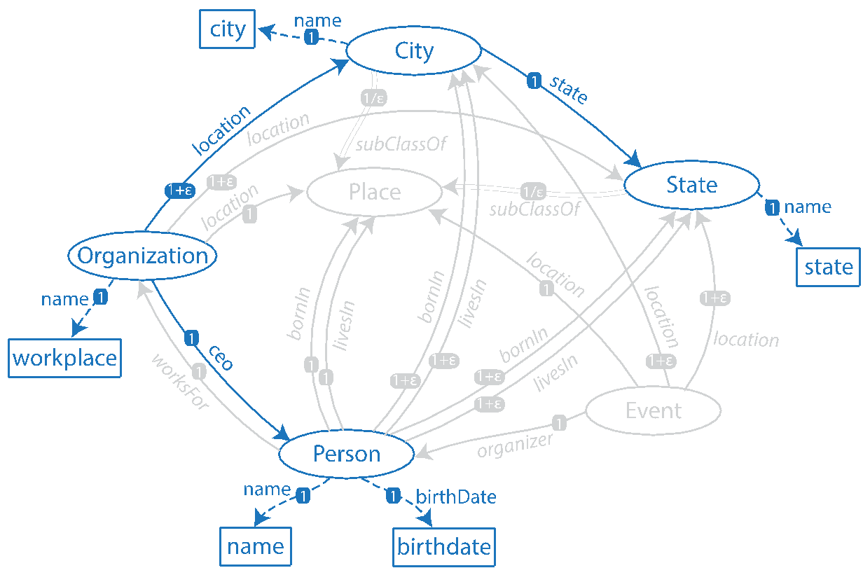
Inferring the Relationships
Select minimal tree that connects all semantic types
A customized Steiner tree algorithm
Initial Model
date
Notes:
The exact approximation ratio is: 2 * (1 – 1/l) where l is the number of leaves in optimal tree.
Paper link: http://www.springerlink.com/content/v7w86m72174k7267/
Volume 15, Number 2, 141-145, DOI: 10.1007/BF00288961
A fast algorithm for Steiner trees
L. Kou, G. Markowsky and L. Berman

Slide 37
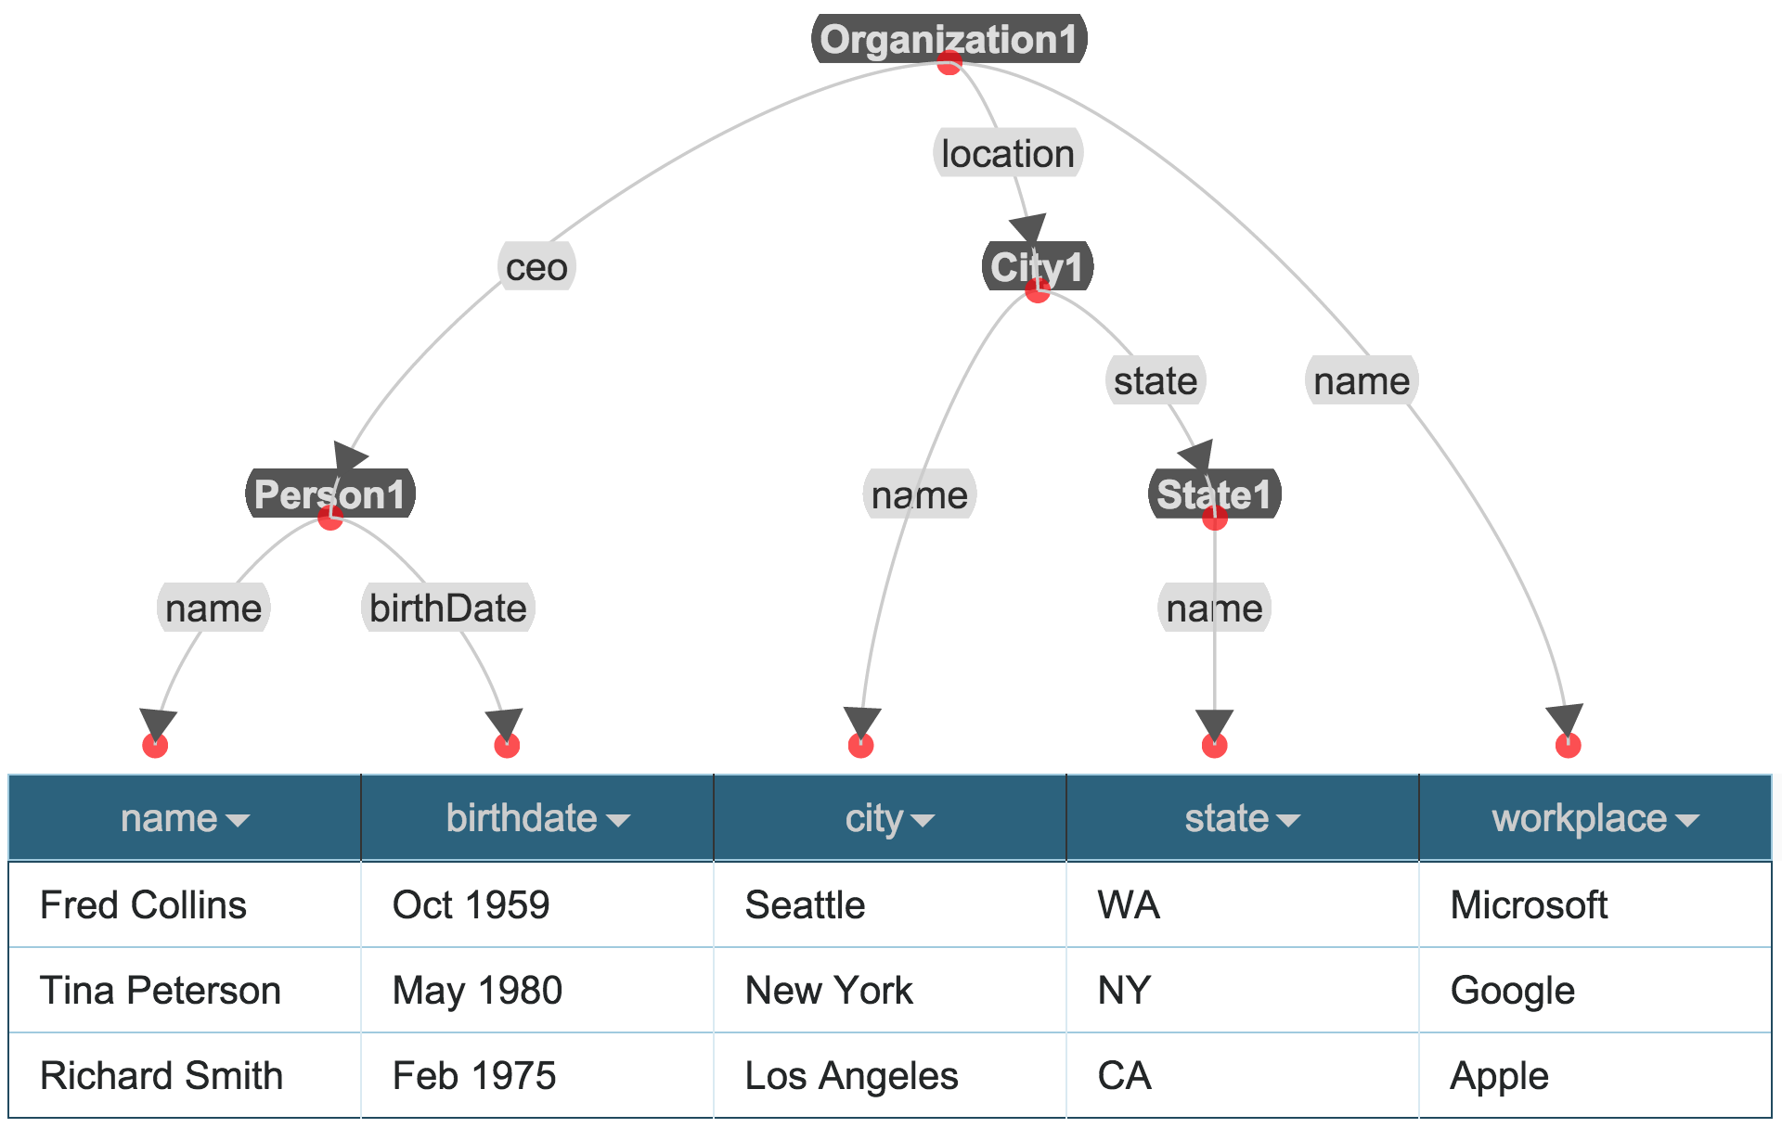
Result in Karma

Slide 38
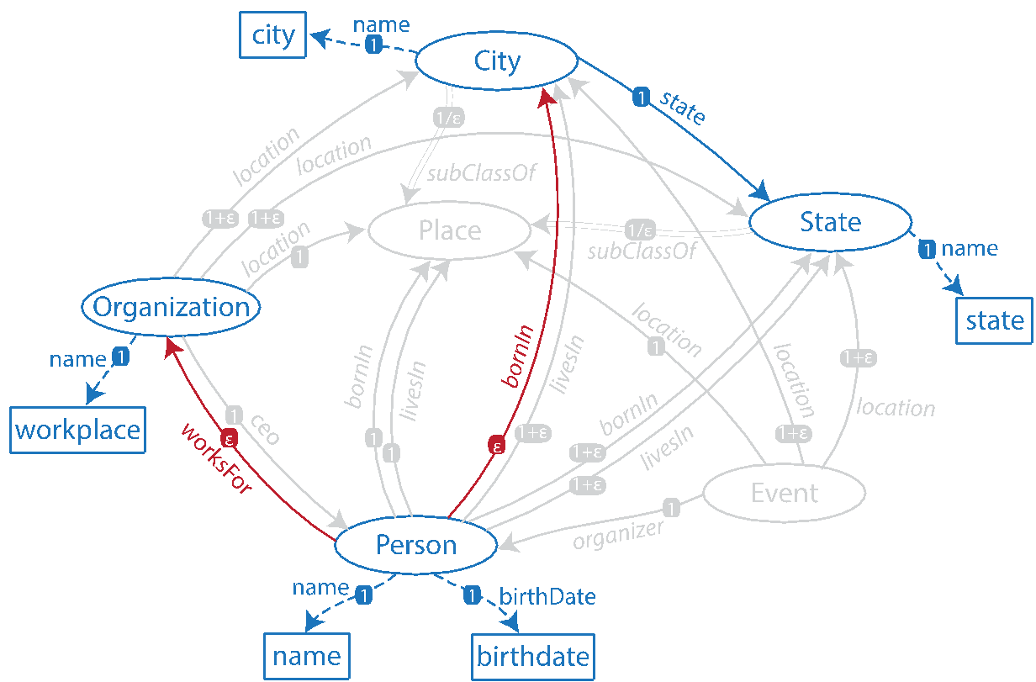
Refining the Model
Impose constraints on Steiner Tree Algorithm
Change weight of selected links to ε
Add source and target of selected link to Steiner nodes
Correct Model
date

Slide 39
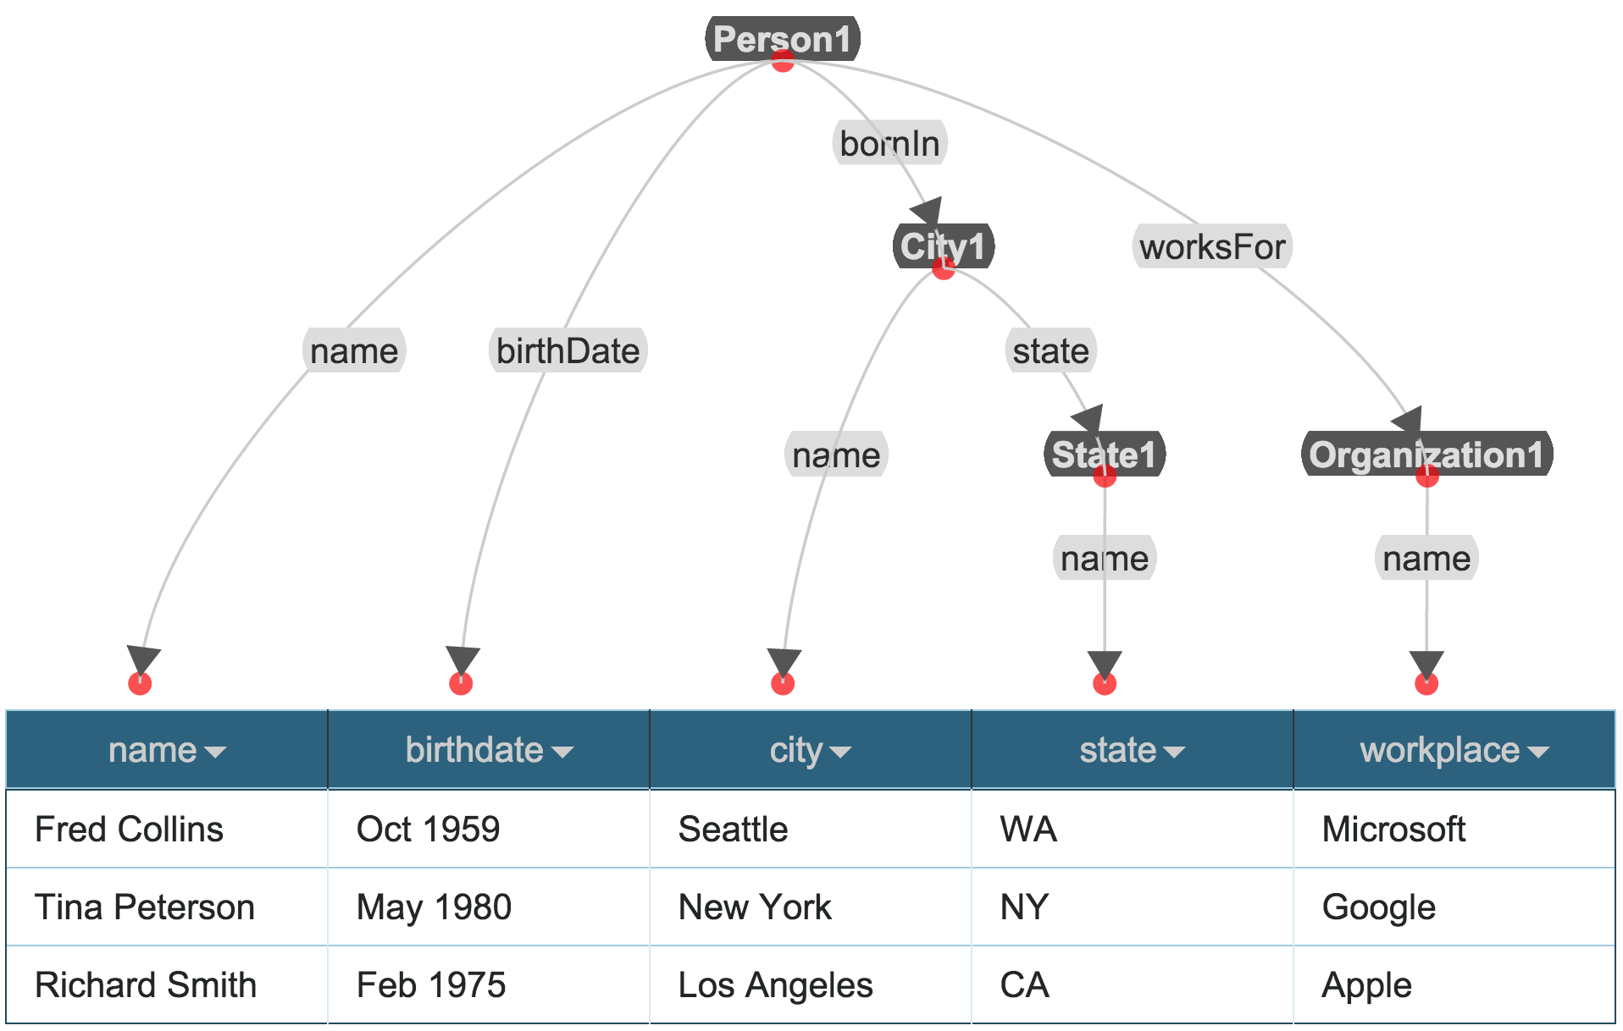
Final Semantic Model

Slide 40
Limitation
This approach does not learn the changes done by the user in relationships
User has to go through the refinement process each time

Slide 41
Improved Approach: Learning Semantic Models [Taheriyan et al., JWS 2015]

Slide 42
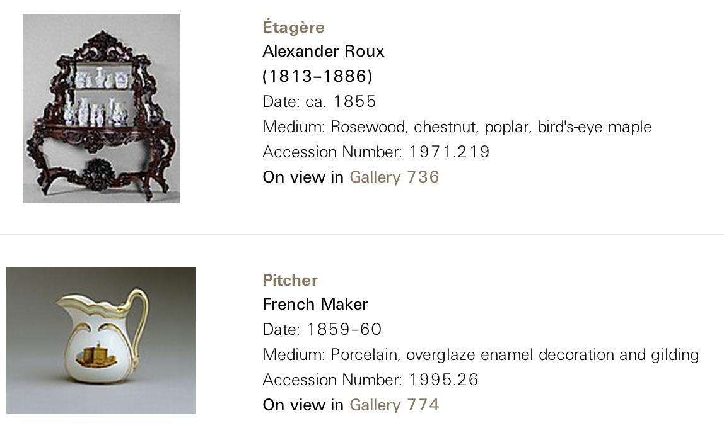
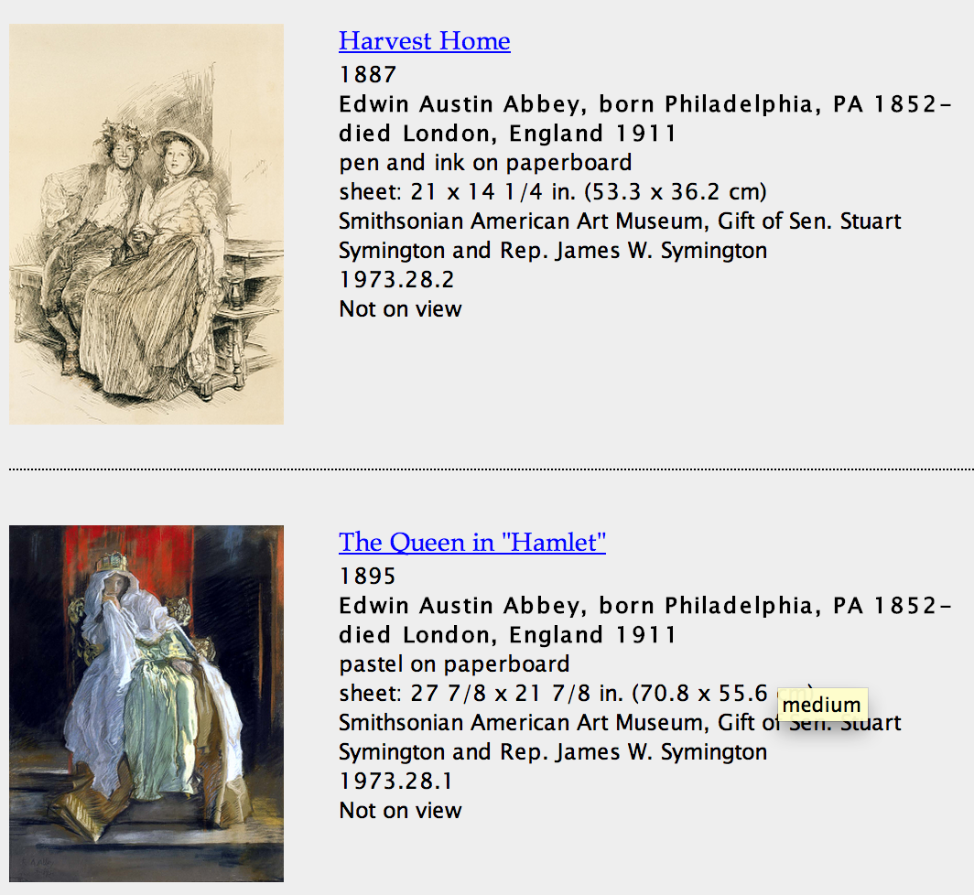
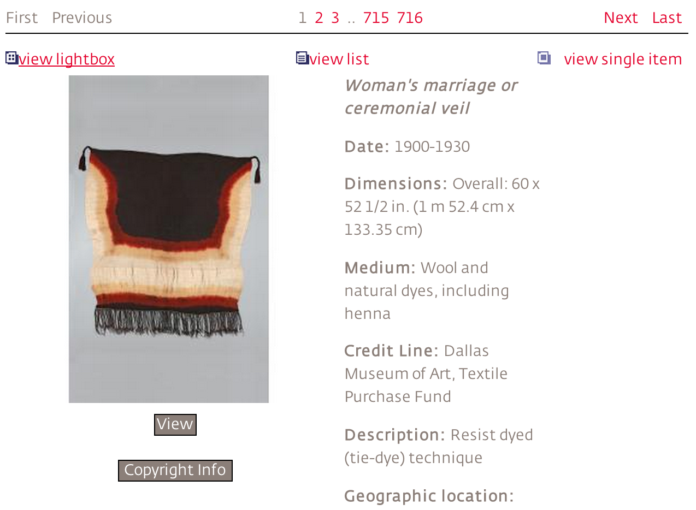

Main Idea
Sources in the same domain often have similar data
Exploit knowledge of known semantic models to hypothesize a semantic model for a new sources
Notes:
http://www.metmuseum.org/collection/the-collection-online/search?deptids=1&amp;pg=1&amp;ft=french&amp;od=on&amp;ao=on&amp;noqs=true
http://americanart.si.edu/collections/search/artwork/results/index.cfm?rows=10&fq=online_media_type%3A%22Images%22&q=Search+by+Artist%2C+Work%2C+or+Keyword&page=1&start=0&x=62&y=5
http://museum.dma.org:9090/emuseum/view/objects/asitem/2031/0/title-desc?t:state:flow=ff495581-e0d2-4334-bec9-19988f9eeb20
http://www.mfah.org/art/100-highlights/commemorative-head-king/
Leverage relationships in known semantic models to hypothesize relationships for new sources

Slide 43
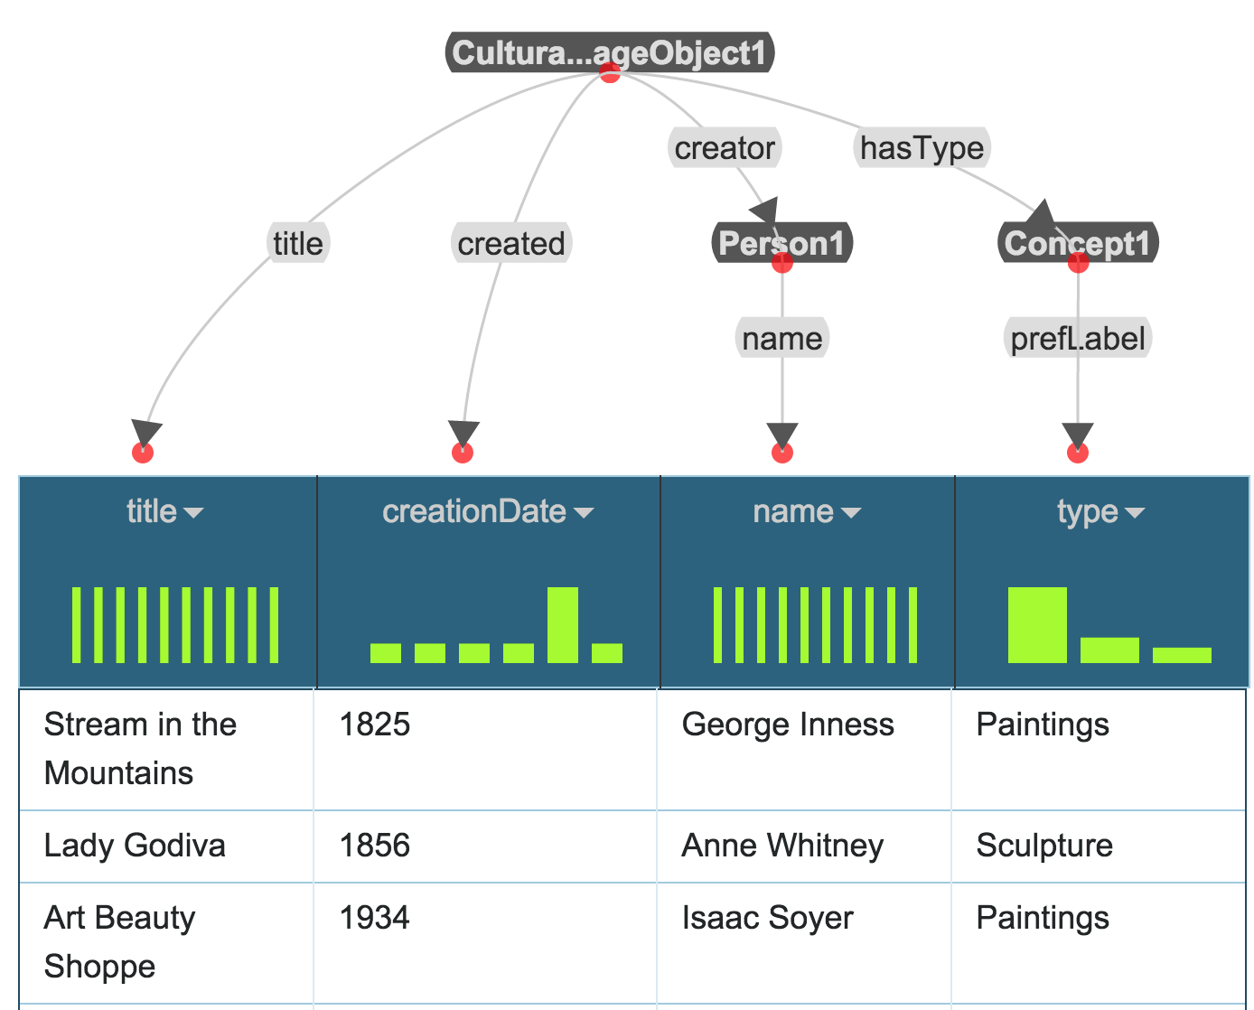
Example
Domain: Museum Data
Domain ontologies:
EDM
SKOS
FOAF
AAC
ORE
ElementsGr2
DCTerms
Source: Dallas Museum of Art ➔ dma(title,creationDate,name,type)

Slide 44
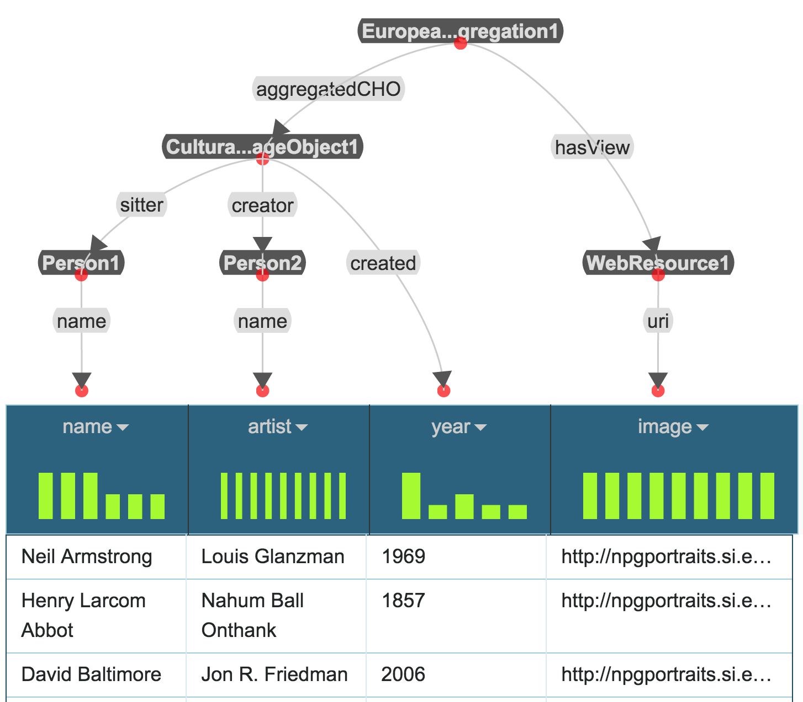
Example
Domain: Museum Data
Domain ontologies:
EDM
SKOS
FOAF
AAC
ORE
ElementsGr2
DCTerms
Source: National Portrait Gallery ➔ npg(name,artist,year,image)

Slide 45
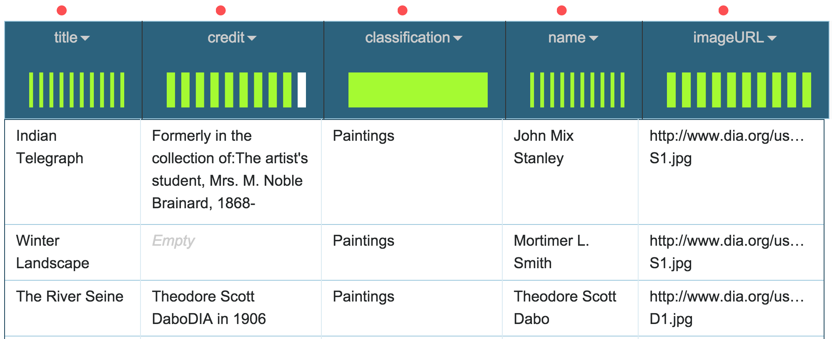
Example
Domain: Museum Data
Domain ontologies:
EDM
SKOS
FOAF
AAC
ORE
ElementsGr2
DCTerms
Source: Detroit Institute of Art ➔ dia(title,credit,classification,name,imageURL)
Goal: Automatically suggest a semantic model for dia

Slide 46
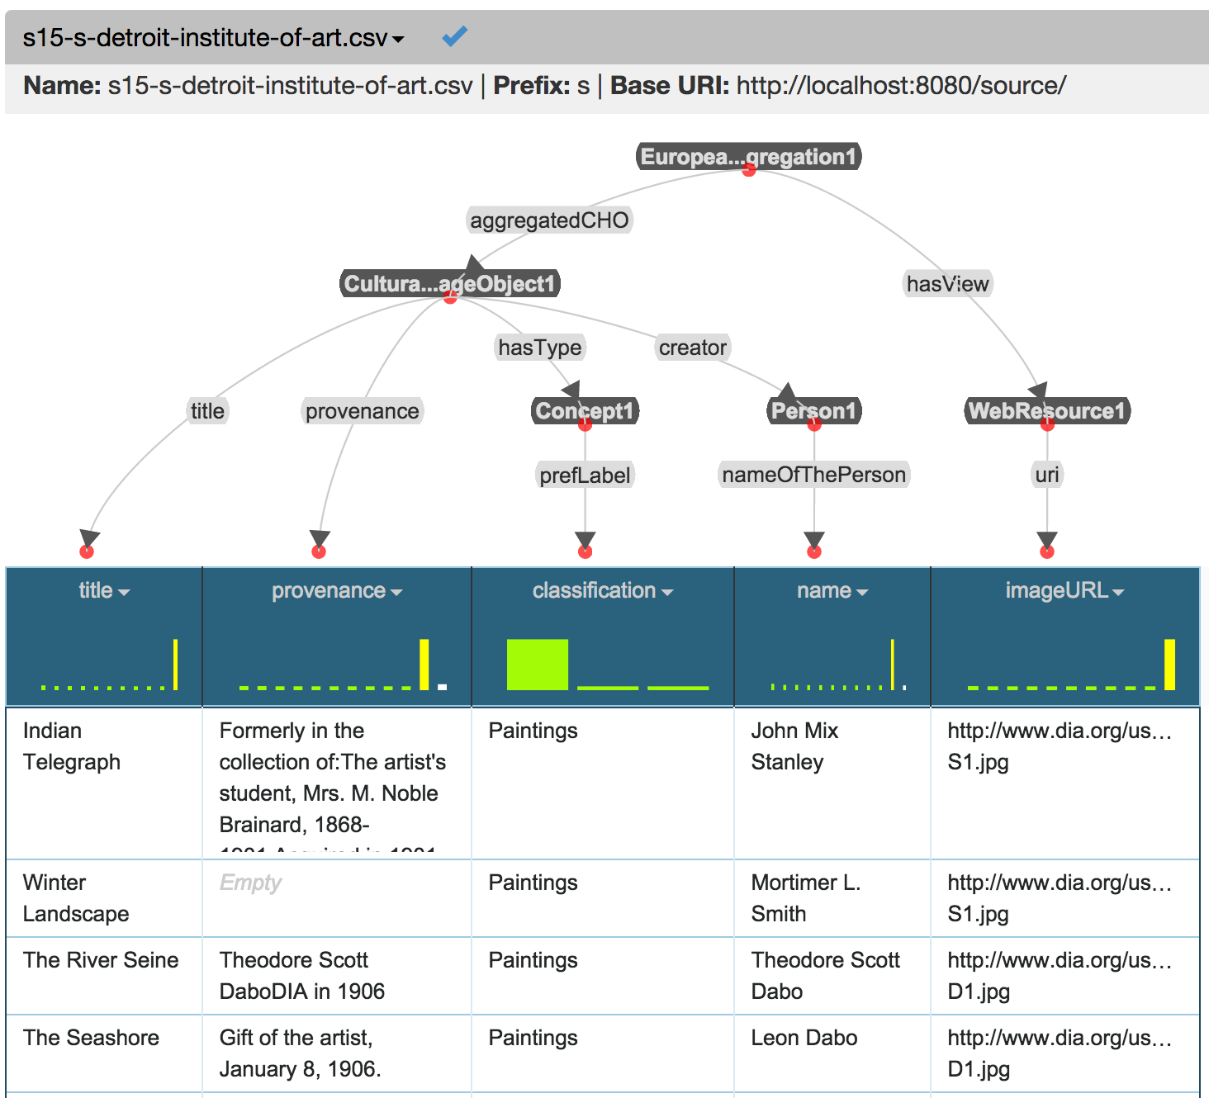

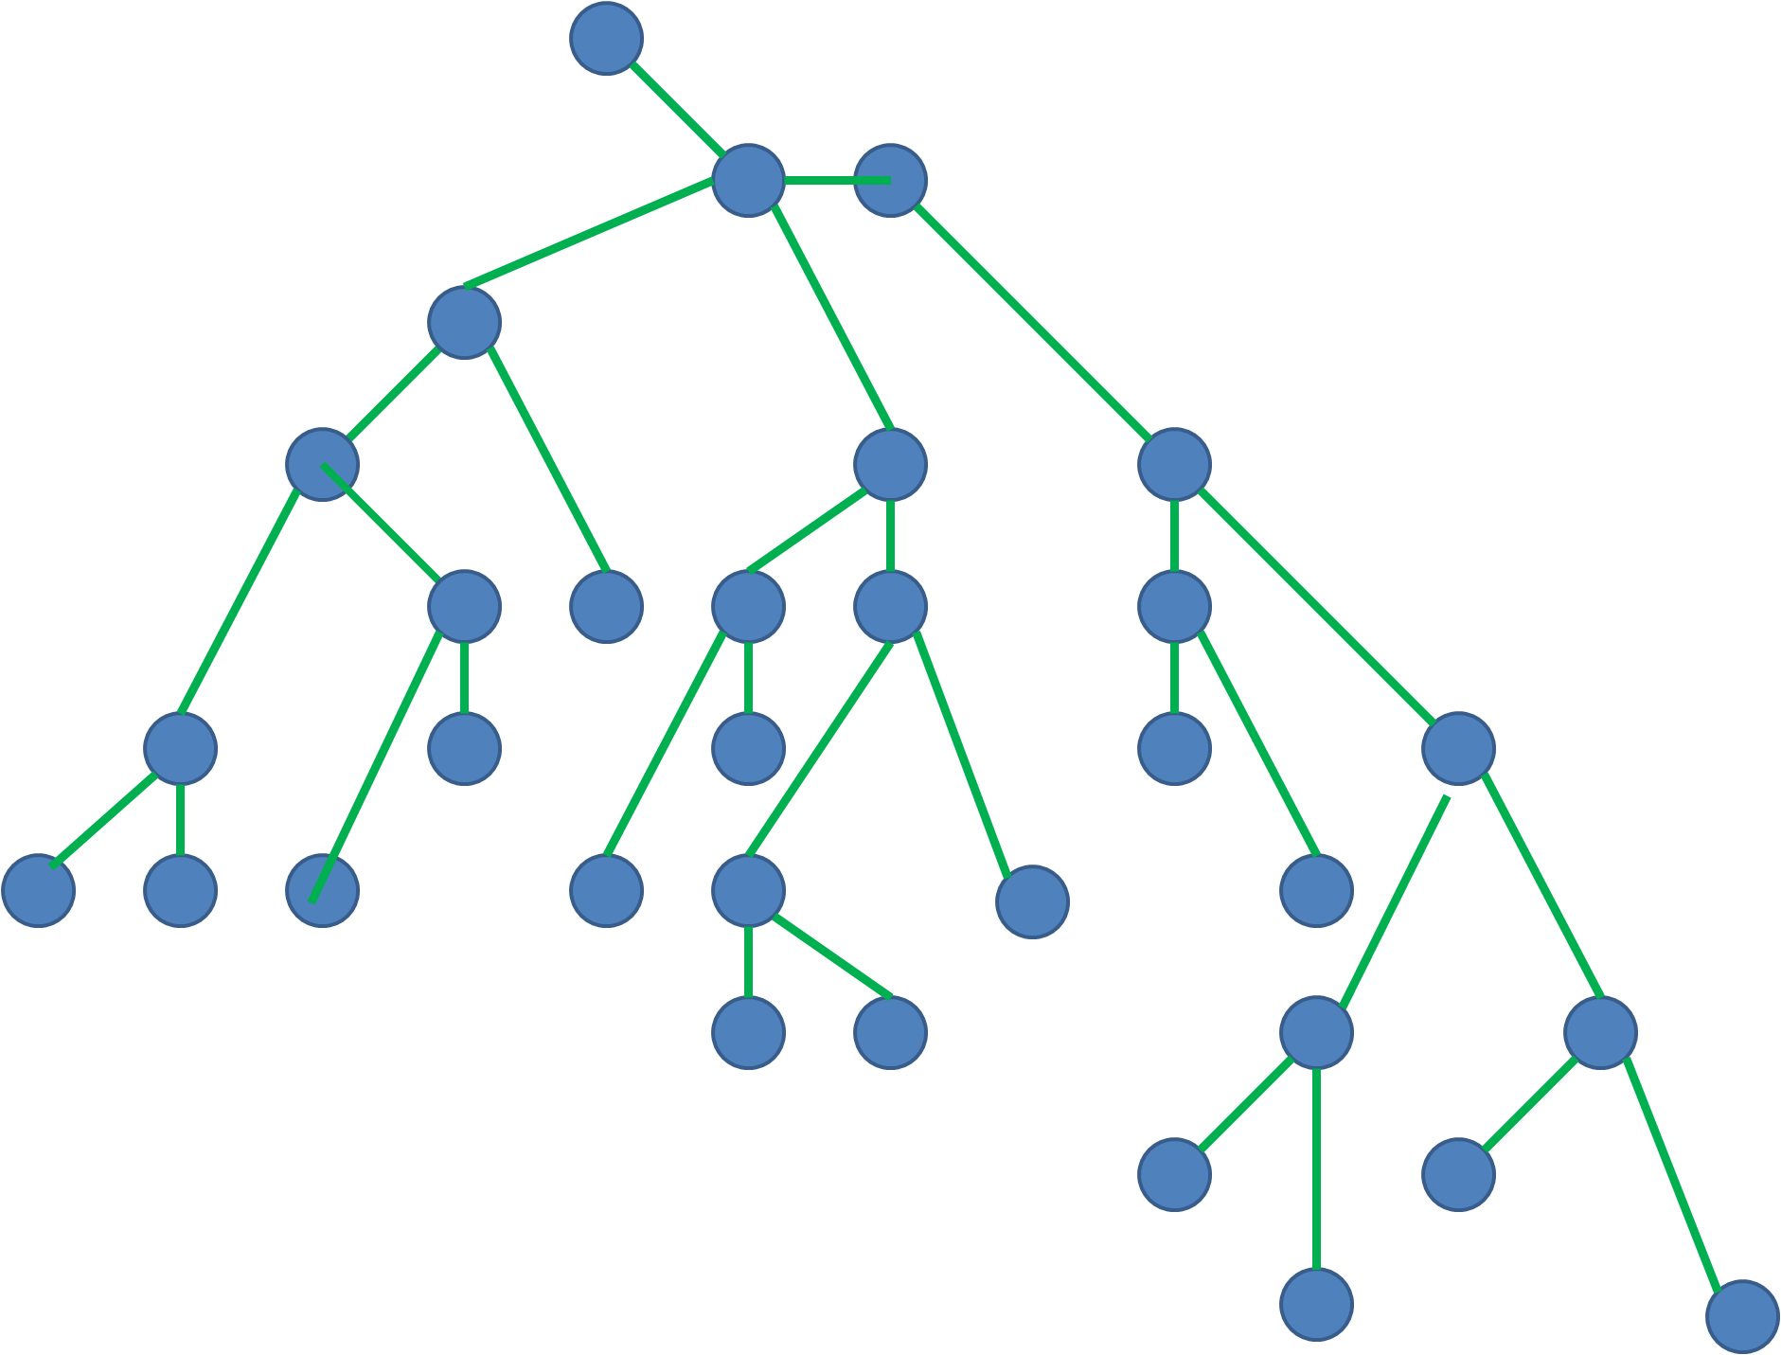
Approach
[Taheriyan et al, JWS 2016]
Sample Data
Learn
Semantic Types
Generate Candidate Models
Construct a Graph
Domain Ontology
Rank Results
Implemented in Karma
Known Semantic Models
Mohsen Taheriyan, Craig A. Knoblock, Pedro Szekely, José Luis Ambite. Learning the semantics of structured data sources. Journal of Web Semantics (37-38), 152-169, 2016,

Slide 47
Approach
Input
Sample data from new source (S)
Domain Ontologies (O)
Known semantic models
1
Learn semantic types for attributes(s)
2
Construct Graph G=(V,E)
3
Generate mappings between attributes(S) and V
4
Generate and rank semantic models
Output
A ranked set of semantic models for S

Slide 48
Approach
Input
Sample data from new source (S)
Domain Ontologies (O)
Known semantic models
1
Learn semantic types for attributes(s)
Construct Graph G=(V,E)
Generate mappings between attributes(S) and V
Generate and rank semantic models
Output
A ranked set of semantic models for S

Slide 49
Learn Semantic Types
Learn Semantic Types for each attribute from its data
Semantic Type: <class_uri, property_uri>
Pick top K semantic types according to their confidence values
dia(title,credit, classification,name,imageURL)
title | <aac:CulturalHeritageObject, dcterms:title> | 0.49
 | <aac:CulturalHeritageObject, rdfs:label> | 0.28
credit | <aac:CulturalHeritageObject, dcterms:provenance> | 0.83
 | <aac:Person, ElementsGr2:note> | 0.06
classification | <skos:Concept, skos:prefLabel> | 0.58
 | <skos:Concept, rdfs:label> | 0.41
name | <aac:Person, foaf:name> | 0.65
 | <fofa:Person, fofaf:name> | 0.32
imageURL | <foaf:Document, uri> | 0.47
 | <edm:WebResource, uri> | 0.40

Slide 50

Approach
Input
Sample data from new source (S)
Domain Ontologies (O)
Known semantic models
Learn semantic types for attributes(s)
2
Construct Graph G=(V,E)
Generate mappings between attributes(S) and V
Generate and rank semantic models
Output
A ranked set of semantic models for S

Slide 51
Build Graph G: Add Known Models
Annotate nodes and links with list of supporting models
Adjust weight based on the number of supporting models
dma
CulturalHeritageObject
dma
1
dma
1
dma
1
created
title
hasType
creator
dma
1
Concept
aac:Person
creationDate
title
dma
1
dma
1
prefLabel
name
type
name

Slide 52
Build Graph G: Add Known Models
Annotate nodes and links with list of supporting models
Adjust weight based on the number of supporting models
dma
npg
EuropeanaAggregation
npg
1
hasView
aggregatedCHO
WebResource
npg
1
npg
1
uri
CulturalHeritageObject
image
dma,npg
0.5
dma
1
dma,npg
0.5
npg
1
created
title
hasType
creator
sitter
dma
1
Concept
aac:Person
aac:Person
creationDate
dma
1
dma,npg
0.5
npg
1
title
prefLabel
name
name
type
name
name

Slide 53
Build Graph G: Add Semantic Types
title | <CulturalHeritageObject,title> <CulturalHeritageObject,label>
credit | <CulturalHeritageObject,provenance> <Person,note>
classification | <Concept,prefLabel> <Concept,label>
name | <aac:Person,name> <foaf:Person,name>
imageURL | <Document,uri> <WebResource,uri>
EuropeanaAggregation
hasView
aggregatedCHO
WebResource
uri
CulturalHeritageObject
image
created
title
hasType
creator
sitter
creationDate
Concept
aac:Person
aac:Person
title
prefLabel
name
name
type
name
name

Slide 54
Build Graph G: Add Semantic Types
title | <CulturalHeritageObject,title> <CulturalHeritageObject,label>
credit | <CulturalHeritageObject,provenance> <Person,note>
classification | <Concept,prefLabel> <Concept,label>
name | <aac:Person,name> <foaf:Person,name>
imageURL | <Document,uri> <WebResource,uri>
EuropeanaAggregation
title
hasView
aggregatedCHO
WebResource
label
uri
CulturalHeritageObject
image
created
title
hasType
creator
sitter
creationDate
Concept
aac:Person
aac:Person
title
prefLabel
name
name
type
name
name

Slide 55
Build Graph G: Add Semantic Types
title | <CulturalHeritageObject,title> <CulturalHeritageObject,label>
credit | <CulturalHeritageObject,provenance> <Person,note>
classification | <Concept,prefLabel> <Concept,label>
name | <aac:Person,name> <foaf:Person,name>
imageURL | <Document,uri> <WebResource,uri>
EuropeanaAggregation
title
hasView
credit
aggregatedCHO
WebResource
label
provenance
uri
CulturalHeritageObject
image
Document
created
title
hasType
creator
sitter
uri
creationDate
Concept
aac:Person
aac:Person
foaf:Person
imageURL
title
prefLabel
label
name
note
name
note
name
type
classification
name
credit
name
credit
name

Slide 56
Build Graph G: Expand with Paths from Ontology
Assign a high weight to the links coming from the ontology
EuropeanaAggregation
page
title
aggregates
1000
1000
credit
1000
hasView
aggregatedCHO
subClassOf
WebResource
label
1000
Aggregation
isShownAt
provenance
aggregates
uri
1000
CulturalHeritageObject
creator
image
Document
1000
created
title
hasType
creator
sitter
uri
creationDate
Concept
aac:Person
aac:Person
foaf:Person
imageURL
title
prefLabel
label
name
note
name
note
name
type
classification
name
credit
name
credit
name

Slide 57
Approach
Input
Sample data from new source (S)
Domain Ontologies (O)
Known semantic models
Learn semantic types for attributes(s)
Construct Graph G=(V,E)
3
Generate mappings between attributes(S) and V
Generate and rank semantic models
Output
A ranked set of semantic models for S

Slide 58
Map Source Attributes to the Graph
title | <CulturalHeritageObject,title> <CulturalHeritageObject,label>
credit | <CulturalHeritageObject,provenance> <Person,note>
classification | <Concept,prefLabel> <Concept,label>
name | <aac:Person,name> <foaf:Person,name>
imageURL | <Document,uri> <WebResource,uri>
EuropeanaAggregation
page
title
aggregates
hasView
credit
aggregatedCHO
WebResource
subClassOf
label
Aggregation
isShownAt
provenance
aggregates
uri
CulturalHeritageObject
creator
image
Document
created
title
hasType
creator
sitter
uri
creationDate
Concept
aac:Person
aac:Person
foaf:Person
imageURL
title
prefLabel
label
name
note
name
note
name
type
classification
name
credit
name
credit
name

Slide 59
Map Source Attributes to the Graph
title | <CulturalHeritageObject,title> <CulturalHeritageObject,label>
credit | <CulturalHeritageObject,provenance> <Person,note>
classification | <Concept,prefLabel> <Concept,label>
name | <aac:Person,name> <foaf:Person,name>
imageURL | <Document,uri> <WebResource,uri>
EuropeanaAggregation
page
title
aggregates
hasView
credit
aggregatedCHO
WebResource
subClassOf
label
Aggregation
isShownAt
provenance
aggregates
uri
CulturalHeritageObject
creator
image
Document
created
title
hasType
creator
sitter
uri
creationDate
Concept
aac:Person
aac:Person
foaf:Person
imageURL
title
prefLabel
label
name
note
name
note
name
type
classification
name
credit
name
credit
name

Slide 60
Map Source Attributes to the Graph
title | <CulturalHeritageObject,title> <CulturalHeritageObject,label>
credit | <CulturalHeritageObject,provenance> <Person,note>
classification | <Concept,prefLabel> <Concept,label>
name | <aac:Person,name> <foaf:Person,name>
imageURL | <Document,uri> <WebResource,uri>
EuropeanaAggregation
page
title
aggregates
hasView
credit
aggregatedCHO
WebResource
subClassOf
label
Aggregation
isShownAt
provenance
aggregates
uri
CulturalHeritageObject
creator
image
Document
created
title
hasType
creator
sitter
uri
creationDate
Concept
aac:Person
aac:Person
foaf:Person
imageURL
title
prefLabel
label
name
note
name
note
name
type
classification
name
credit
name
credit
name

Slide 61
Scalability Issue
Multiple mappings from attributes(S) to nodes of G
Each attribute has more than one semantic type
Multiple matches for each semantic type
Not feasible to generate all possible mappings
The size of graph may be large
The source may have many attributes
Exponential in terms of number of attributes
N attributes, M matches for each → M^{N} mappings

Slide 62
Prune the Mappings
Score the partial mappings after mapping each attribute
Coherence: number of nodes in a mapping that belong to same component
Confidence: average confidence of semantic types in m
Score = arithmetic mean of coherence and confidence
Beam Search
Keep only top K mappings after mapping each attribute
Number of mappings will not exceed a fixed size after mapping each attribute

Slide 63
Approach
Input
Sample data from new source (S)
Domain Ontologies (O)
Known semantic models
Learn semantic types for attributes(s)
Construct Graph G=(V,E)
Generate mappings between attributes(S) and V
4
Generate and rank semantic models
Output
A ranked set of semantic models for S

Slide 64
Generate Semantic Models
Compute Top-K Steiner tree for each mapping
A minimal tree connecting nodes of mapping
A customization of BANKS algorithm [Bhalotia et al., 2002]
Each tree is a candidate model
Rank candidate models (Steiner trees)
Coherence of the links (how many links belong to the same known model)
Popularity of the links (cost, sum of weights)
Notes:
Keyword Searching and Browsing in Databases using BANKS

Slide 65
Why Coherence is Important?
Known Models
organizer
location
bornIn
bornIn
Person
Event
Place
Person
Place
Person
Place
s1
s2
s3

Slide 66
Why Coherence is Important?
Known Models
organizer
location
bornIn
bornIn
Person
Event
Place
Person
Place
Person
Place
s1
s2
s3
organizer
location
1
s1
1
s1
Graph
Person
Event
Place
0.5
bornIn
s2, s3

Slide 67
Why Coherence is Important?
Known Models
organizer
location
bornIn
bornIn
Person
Event
Place
Person
Place
Person
Place
s1
s2
s3
organizer
location
Person
1
1
Semantic types
of a new source
Graph
s1
s1
Person
Event
Place
Event
0.5
bornIn
Place
s2, s3

Slide 68
Why Coherence is Important?
Known Models
organizer
location
bornIn
bornIn
Person
Event
Place
Person
Place
Person
Place
s1
s2
s3
organizer
location
Person
1
1
Semantic types
of a new source
Graph
s1
s1
Person
Event
Place
Event
0.5
bornIn
Place
s2, s3
Top 3 Steiner trees
organizer
location
organizer
location
1
1
s1
1
s1
1
s1
s1
Person
Event
Place
Person
Event
Place
Person
Event
Place
0.5
bornIn
0.5
bornIn
s2, s3
s2, s3

Slide 69
Example Mapping
title | <CulturalHeritageObject,title> <CulturalHeritageObject,label>
credit | <CulturalHeritageObject,provenance> <Person,note>
classification | <Concept,prefLabel> <Concept,label>
name | <aac:Person,name> <foaf:Person,name>
imageURL | <Document,uri> <WebResource,uri>
EuropeanaAggregation
page
title
hasView
credit
aggregates
WebResource
subClassOf
aggregatedCHO
Aggregation
label
isShownAt
provenance
aggregates
uri
CulturalHeritageObject
creator
image
Document
created
title
hasType
creator
sitter
uri
creationDate
Concept
aac:Person
aac:Person
foaf:Person
imageURL
title
prefLabel
label
name
note
name
note
name
type
classification
name
credit
name
credit
name

Slide 70
Steiner Tree
title | <CulturalHeritageObject,title> <CulturalHeritageObject,label>
credit | <CulturalHeritageObject,provenance> <Person,note>
classification | <Concept,prefLabel> <Concept,label>
name | <aac:Person,name> <foaf:Person,name>
imageURL | <Document,uri> <WebResource,uri>
EuropeanaAggregation
page
title
hasView
credit
aggregates
WebResource
subClassOf
aggregatedCHO
Aggregation
label
isShownAt
provenance
aggregates
uri
CulturalHeritageObject
creator
image
Document
created
title
hasType
creator
sitter
uri
creationDate
Concept
aac:Person
aac:Person
foaf:Person
imageURL
title
prefLabel
label
name
note
name
note
name
type
classification
name
credit
name
credit
name

Slide 71
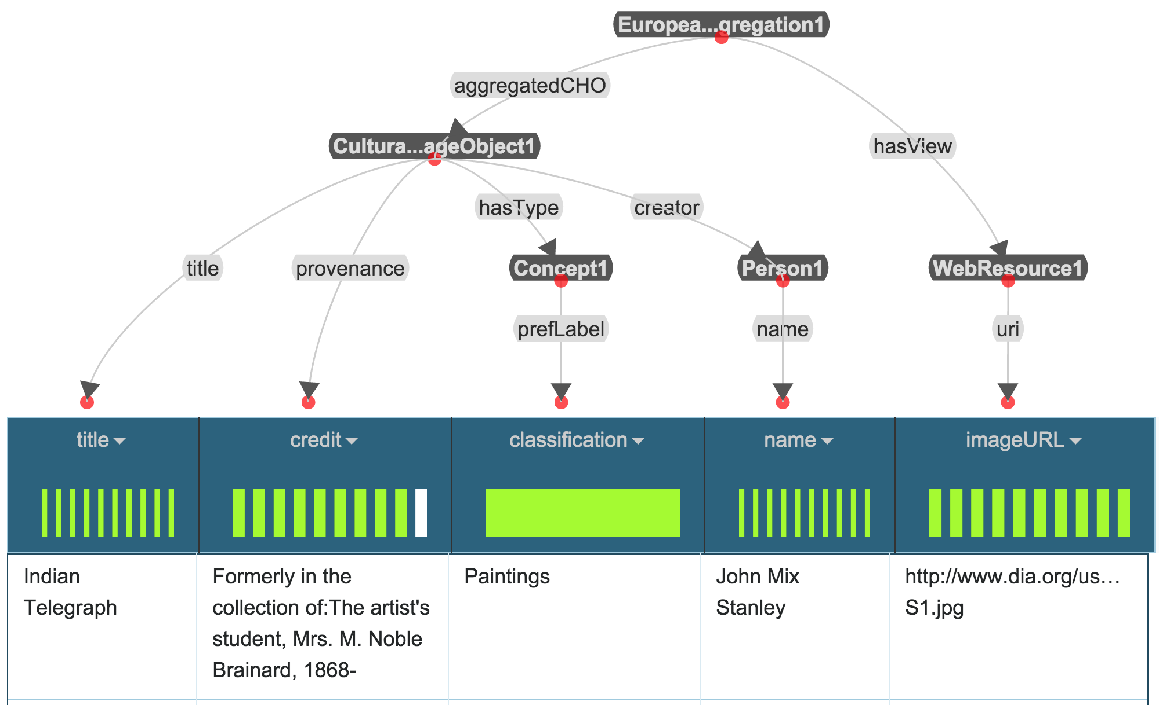
Final Model in Karma
Domain: Museum Data
Domain ontologies:
EDM
SKOS
FOAF
AAC
ORE
ElementsGr2
DCTerms
Source: Detroit Institute of Art ➔ dia(title,credit,classification,name,imageURL)

Slide 72
Evaluation
Dataset | Ontology | Gold Standard Models
29 museum data sources 458 attributes (columns) | CRM 147 classes 409 properties | 852 nodes 825 links
29 museum data sources 329 attributes | EDM 147 classes 409 properties | 470 nodes 441 links
Notes:
#source
29
#attributes
331
#classes in the ontologies
119
#properties in the ontologies
351
#nodes in the gold-standard models
473
#data nodes in the gold-standard models
331
#class nodes in the gold-standard models
142
#links in the gold-standard models
444
#links between class nodes in the gold-standard models
113

Slide 73
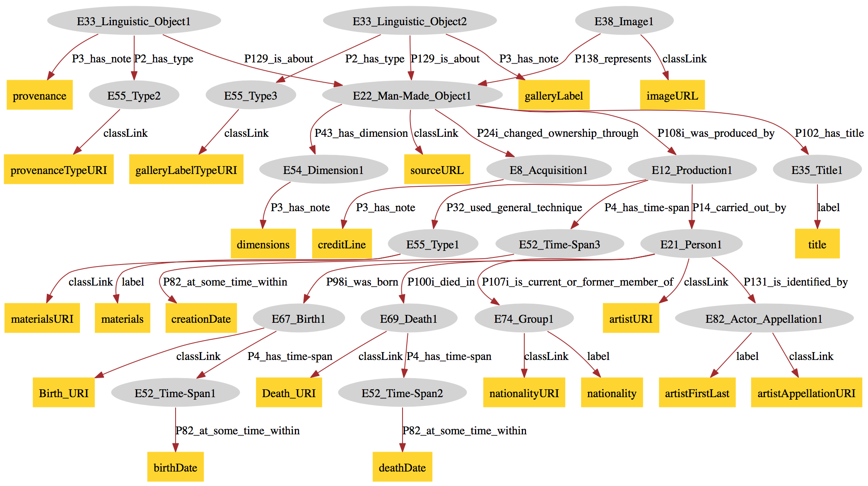
Example Gold Standard Models
Notes:
Indiana Museum of Art

Slide 74
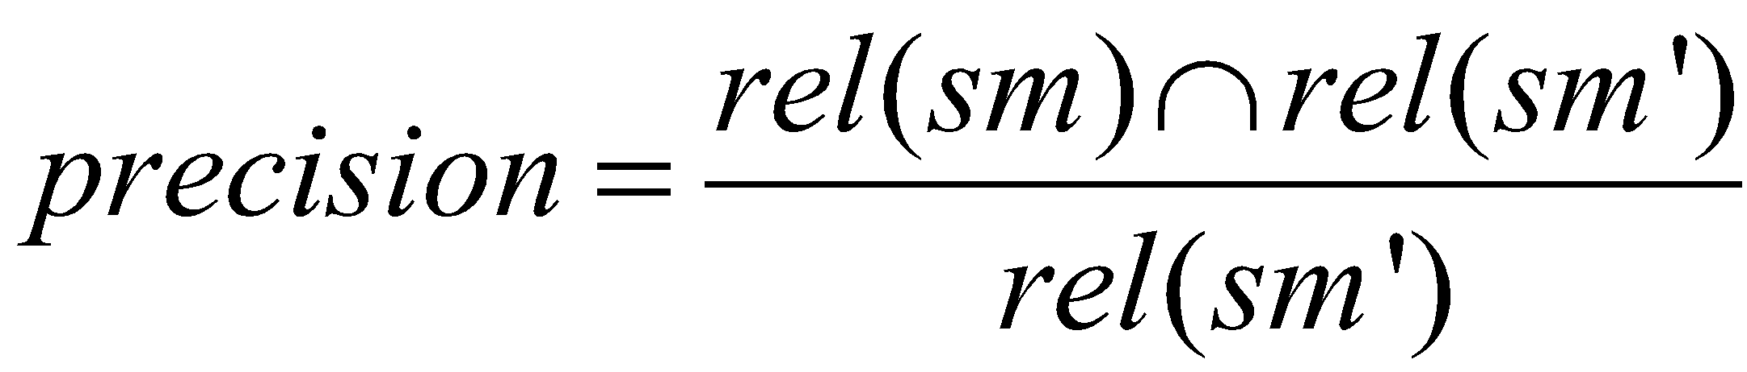
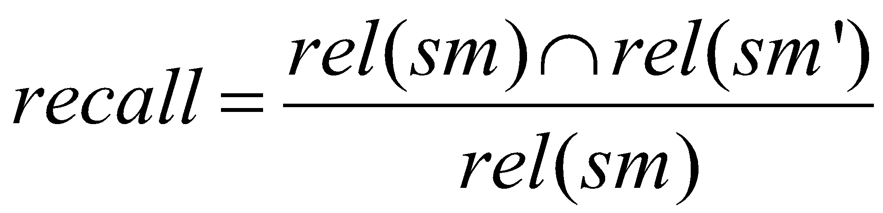
Evaluation
Compute precision and recall (between the learned links and the correct links)
How many of the learned relationships are correct?
How many of the correct relationships are learned?
sm: correct model
sm`: learned model
rel: set of <source, link, target> triples

Slide 75
Example
Artwork
Museum
location
creator
location
founder
Museum
Person
Artwork
Person
correct model
learned model
<Artwork,museum,Museum>
<Artwork,creator,Person>
<Artwork,museum,Museum>
<Museum,founder,Person>
Precision: 0.5 Recall: 0.5

Slide 76
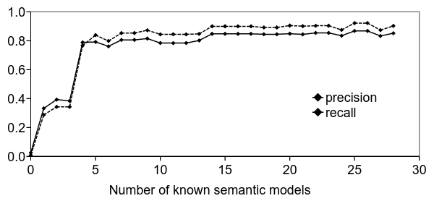
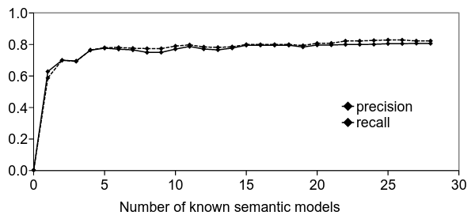
Experiment 1
correct semantic types are given
EDM
CRM

Slide 77
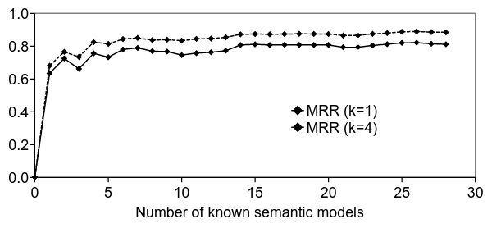

Experiment 2
learn semantic types, pick top K candidates
EDM
CRM
Notes:
MRR: https://en.wikipedia.org/wiki/Mean_reciprocal_rank

Slide 78
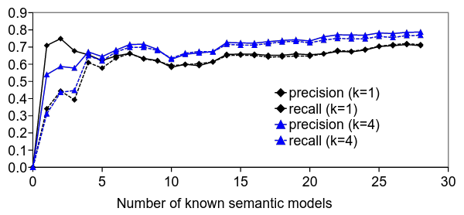
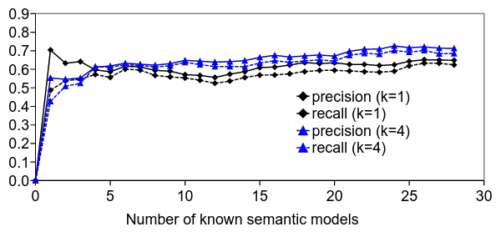
Experiment 2
learn semantic types, pick top K candidates
EDM
CRM

Slide 79
Limitation
Lack of sufficient known semantic models is some domains

Slide 80
Leveraging Linked Data to Discover Semantic Relations within Data Sources

Slide 81
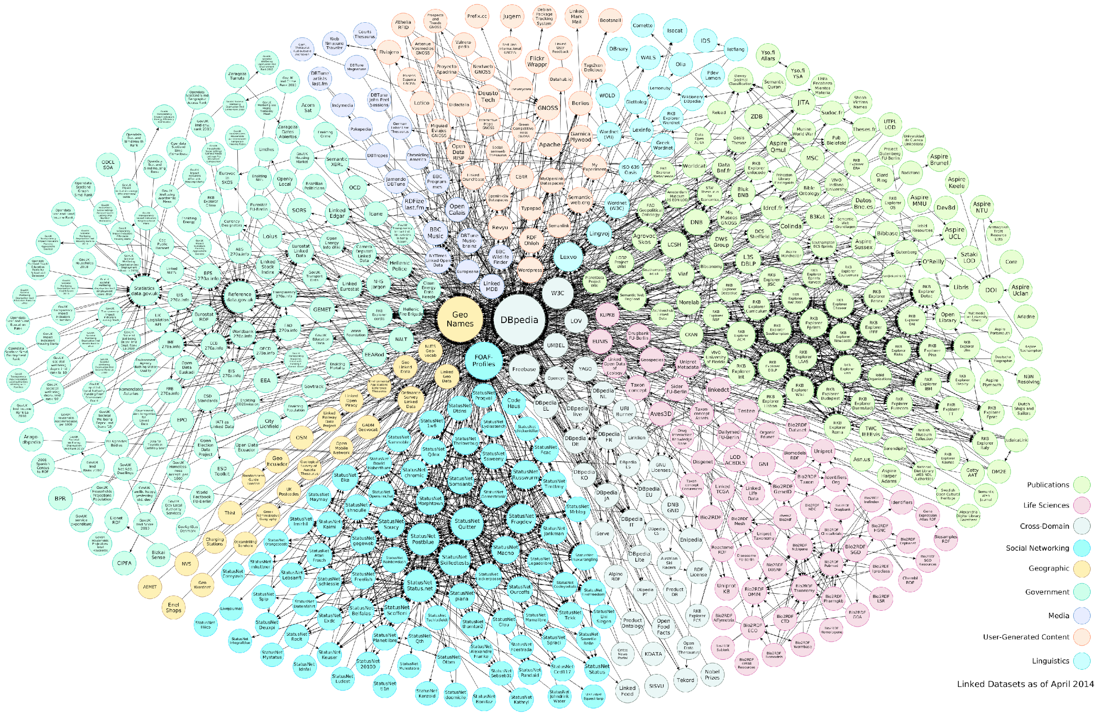
Idea
Exploit the relationships within already published linked data
Notes:
Example: British Museum Dataset
There is a huge amount of linked data available in many domains (RDF format)
Use LOD when there is no known semantic model

Slide 82

Approach [Taheriyan et al, ISWC 2016]
Sample Data
Learn
Semantic Types
Generate Candidate Models
Construct a Graph
Domain Ontology
Rank Results
Extract Patterns
Linked Open Data
Taheriyan, M.; Knoblock, C.; Szekely, P.; and Ambite, J. L. Leveraging Linked Data to Discover Semantic Relations within Data Sources. In 15th International Semantic Web Conference (ISWC), 2016.

Slide 83
Approach
Input
Output
A ranked set of semantic models for S
Target source (S)
Domain Ontologies (O)
Semantic labels of S
Linked Data (in the same domain)
1
Extract schema-level graph patterns from LD
2
Construct a graph from LD patterns and the ontology
3
Generate and rank semantic models

Slide 84
Approach
Input
Output
A ranked set of semantic models for S
Target source (S)
Domain Ontologies (O)
Semantic labels of S
Linked Data (in the same domain)
1
Extract schema-level graph patterns from LD
2
Construct a graph from LD patterns and the ontology
3
Generate and rank semantic models

Slide 85
Schema-Level LD Patterns
../person-institution/57551
rdf:type
LD fragment from the British Museum
E21_Person
skos:prefLabel
Thomas Burgon
../person-institution/57551/birth
rdf:type
E67_Birth
P98i_was_born
P4_has_time-span
../person-institution/57551/birth/date
rdf:type
E52_Time-Span
rdfs:label
1787

Slide 86
Schema-Level LD Patterns
../person-institution/57551
rdf:type
LD fragment from the British Museum
E21_Person
skos:prefLabel
Thomas Burgon
../person-institution/57551/birth
rdf:type
E67_Birth
P98i_was_born
P4_has_time-span
../person-institution/57551/birth/date
rdf:type
E52_Time-Span
Pattern
rdfs:label
1787
P98i_was_born
P4_has_time-span
E21_Person
E67_Birth
E52_Time-Span

Slide 87
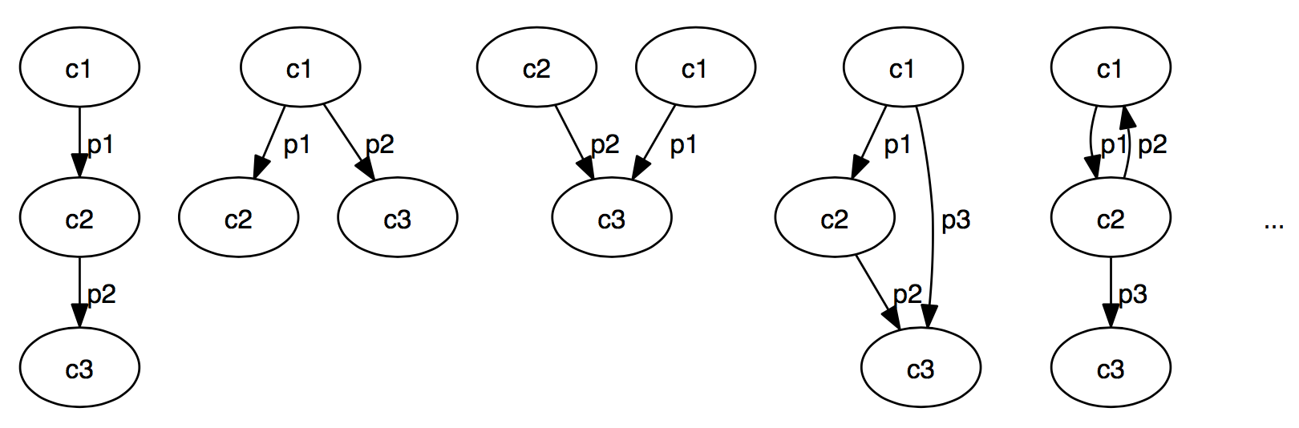
Pattern Templates
Many possible templates for patterns
Example: patterns for classes C1, C2, C3
Consider only tree patterns
Limit the length of the patterns

Slide 88
Extracting LD Patterns
Use SPARQL to extract patterns of length one
organizer
location
born
length 1
Person
Event
Event
Place
Person
Place
Notes:
SELECT DISTINCT ?c1 ?p ?c2 (COUNT(*) as ?count)
WHERE { ?x ?p ?y.
?x rdf:type ?c1.
?y rdf:type ?c2.
FILTER (?x != ?y).}
GROUP BY ?c1 ?p ?c2
ORDER BY DESC(?count);

Slide 89
Extracting LD Patterns
Iteratively construct larger patterns by joining with patterns of length 1
organizer
location
Event
Person
Person
Event
Place
location
born
Place
Person
born
Person
length 2
organizer
born
born
Event
Place
Place
Place
Event
location
organizer
Person
organizer
location
Place
Place
Event
Event

Slide 90
Extracting LD Patterns
Filter out the patterns not appearing in the data
organizer
location
Event
Person
Person
Event
Place
location
born
Place
Person
born
Person
organizer
born
born
Event
Place
Place
Place
Event
location
organizer
Person
organizer
location
Place
Place
Event
Event

Slide 91
Approach
Input
Output
A ranked set of semantic models for S
Target source (S)
Domain Ontologies (O)
Semantic labels of S
Linked Data (in the same domain)
1
Extract schema-level graph patterns from LD
2
Construct a graph from LD patterns and the ontology
3
Generate and rank semantic models

Slide 92
Merge the Patterns into a Graph
Start from longer patterns, skip the ones already in the graph
E22_Man-Made_Object
P102_has_title
P108i_was_produced_by
P14_carried_out_by
E53_Title
E12_Production
E21_Person
E39_Actor
P98i_was_born
P131_is_identified_by
P131_is_identified_by
P4_has_time-span
E52_Time-Span
E67_Birth
E82_Actor_Appellation
P4_has_time-span
Notes:
P131 is identified by is more popular than P1 is identified by to connect instances of E82 Actor Appellation and instances of E21 Person: The property P1 is identified by describes the naming or identification of any real world item by a name or any other identifier, and P131 is identified by is a specialization of P1 is identified by that identifies a name used specifically to identify an instance of E39 Actor (superclass of E21 Person).

Slide 93
Weighting the Links
Less weight for more popular links
W = (1 - freq)/(total count of links)
0.70
E22_Man-Made_Object
0.84
0.87
P102_has_title
P108i_was_produced_by
P14_carried_out_by
E53_Title
E12_Production
E21_Person
E39_Actor
0.92
0.80
0.68
0.95
P98i_was_born
P131_is_identified_by
P131_is_identified_by
P4_has_time-span
0.92
E52_Time-Span
E67_Birth
E82_Actor_Appellation
P4_has_time-span

Slide 94
Coherence
Links from the same pattern have the same tag
0.70
E22_Man-Made_Object
0.84
0.87
P102_has_title
P108i_was_produced_by
P14_carried_out_by
m1
m2
m5
E53_Title
E12_Production
E21_Person
E39_Actor
0.92
0.80
0.68
0.95
m2
P98i_was_born
P131_is_identified_by
P131_is_identified_by
P4_has_time-span
m3
m4
m5
0.92
E52_Time-Span
E67_Birth
E82_Actor_Appellation
P4_has_time-span
m3

Slide 95
Add the paths from the Ontology
High weights for links that do not have any instance in the data
0.70
E22_Man-Made_Object
0.84
0.87
100
P102_has_title
P108i_was_produced_by
P14_carried_out_by
P14_carried_out_by
m1
m2
m5
E53_Title
E12_Production
E21_Person
E39_Actor
0.92
0.80
0.68
0.95
m2
P98i_was_born
P131_is_identified_by
P131_is_identified_by
P4_has_time-span
m3
m4
m5
0.92
E52_Time-Span
E67_Birth
E82_Actor_Appellation
P4_has_time-span
m3

Slide 96
Approach
Input
Output
A ranked set of semantic models for S
Target source (S)
Domain Ontologies (O)
Semantic labels of S
Linked Data (in the same domain)
1
Extract schema-level graph patterns from LD
2
Construct a graph from LD patterns and the ontology
3
Generate and rank semantic models

Slide 97
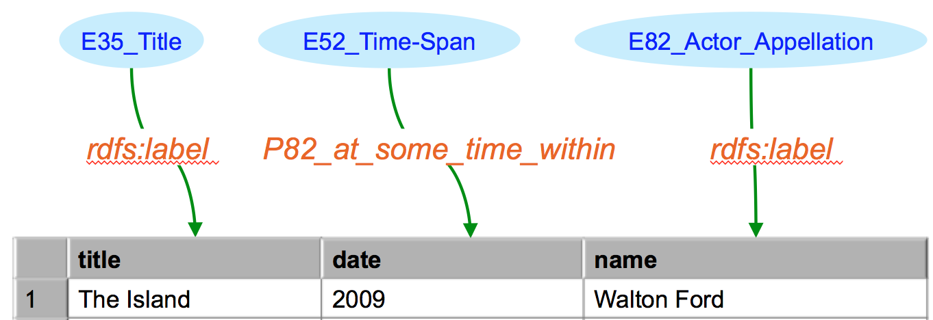
Map Semantic Labels to the Graph
0.70
E22_Man-Made_Object
0.84
0.87
100
P102_has_title
P108i_was_produced_by
P14_carried_out_by
P14_carried_out_by
m1
m2
m5
E53_Title
E12_Production
E21_Person
E39_Actor
0.92
0.80
0.68
0.95
m2
P98i_was_born
P131_is_identified_by
P131_is_identified_by
P4_has_time-span
m3
m4
m5
0.92
E52_Time-Span
E67_Birth
E82_Actor_Appellation
P4_has_time-span
m3

Slide 98
Map Semantic Labels to the Graph
0.70
E22_Man-Made_Object
0.84
0.87
100
P102_has_title
P108i_was_produced_by
P14_carried_out_by
P14_carried_out_by
m1
m2
m5
E53_Title
E12_Production
E21_Person
E39_Actor
0.92
0.80
0.68
0.95
m2
P98i_was_born
P131_is_identified_by
P131_is_identified_by
P4_has_time-span
m3
m4
m5
0.92
E52_Time-Span
E67_Birth
E82_Actor_Appellation
P4_has_time-span
m3

Slide 99
Generate Semantic Models
Compute top k minimal trees
Consider both coherence and popularity
0.70
E22_Man-Made_Object
0.84
0.87
100
P102_has_title
P108i_was_produced_by
P14_carried_out_by
P14_carried_out_by
m1
m2
m5
E53_Title
E12_Production
E21_Person
E39_Actor
0.92
0.80
0.68
0.95
m2
P98i_was_born
P131_is_identified_by
P131_is_identified_by
P4_has_time-span
m3
m4
m5
0.92
E52_Time-Span
E67_Birth
E82_Actor_Appellation
P4_has_time-span
m3
Notes:
Compute Steiner tree for the mapping
A minimal tree connecting nodes of mapping
A customization of BANKS algorithm [Bhalotia et al., 2002]
Our algorithm considers both coherence and popularity
Each tree is a candidate model
Rank the models based on coherence and cost

Slide 100
Evaluation
Dataset | Ontology | Gold Standard Models | Linked Data
29 museum data sources 458 attributes (columns) | CRM 147 classes 409 properties | 852 nodes 825 links | RDF generated from the same dataset (leave-one-out)
29 museum data sources 458 attributes | CRM 147 classes 409 properties | 852 nodes 825 links | RDF published by Smithsonian American Art Museum (more than 3 million triples)
29 museum data sources 329 attributes | EDM 147 classes 409 properties | 470 nodes 441 links | RDF generated from the same dataset (leave-one-out)
15 sources containing data about weapon ads 175 attributes | schema.org (ext) 736 classes 1081 properties | 261 nodes 246 links | RDF generated from the same dataset (leave-one-out)
Notes:
#data source 29
#classes in the domain ontologies 147
#properties in the domain ontologies 409
#nodes in the gold-standard models 812
#data nodes in the gold-standard models 418
#class nodes in the gold-standard models 394
#links in the gold-standard models 785
#internal links in the gold-standard models 367
68 distinct patterns with length one (two nodes and one link)
634 distinct patterns with length two (three nodes and two links)

Slide 101
Results
max len of patterns | Museum CRM (leave-one-out) |  | Museum CRM (Smithsonian LD) |  | Museum EDM |  | Weapon schema.org
 | precision | recall | precision | recall | precision | recall | precision | recall
0 | 0.07 | 0.05 | 0.07 | 0.05 | 0.01 | 0.01 | 0.03 | 0.02
1 | 0.60 | 0.60 | 0.28 | 0.29 | 0.85 | 0.78 | 0.84 | 0.79
2 | 0.64 | 0.67 | 0.53 | 0.58 | 0.81 | 0.81 | 0.83 | 0.79
... | ... | ... | ... | ... | ... | ... | ... | ...
5 | 0.75 | 0.77 | 0.61 | 0.67 | 0.83 | 0.82 | 0.86 | 0.82
Very low accuracy if only using the ontology paths
Considering coherence improves the quality of the models (longer patterns increase the accuracy)
Higher precision & recall for less complex ontologies
Notes:
length = 0: This low accuracy comes from the fact that in most of the gold standard models, the attributes are not directly connected and there are multiple paths between each pair of classes in the ontology (and thus in our graph), and without additional information we cannot resolve the ambiguity.
We achieve high precision and recall in Task 4. The ontology in this task is much larger than the ontologies in the other tasks (cf. Table 2), however, the hierarchy level is less than the CIDOC-CRM ontology, and the models are also smaller. We believe that extracting longer patterns (length > 5) will improve the results for Task 1 and Task 2 as many of the semantic models in these tasks include more than 5 internal links.
Low accuracy if only using the ontology paths (no pattern from linked data)
Considering coherence improves the quality of the models (longer patterns increase the accuracy)
Higher precision & recall for less complex and less structured ontologies (less ambiguity)
Why not 100% accuracy?
Not much overlap between the source model and the linked data (e.g., no instance of the class in the data)
Conflict resolution, sometime more than one pattern fits
Some ground truth models are not rooted trees
Our evaluation metric is too strict (inverse links, super classes)

Slide 102
Karma Use Cases

Slide 103

VIVO
VIVO is a system to build researcher networks across institutions
Used Karma to map the data about USC faculty to VIVO ontology and publish it as RDF
VIVO ingest the RDF data
Video

Slide 104
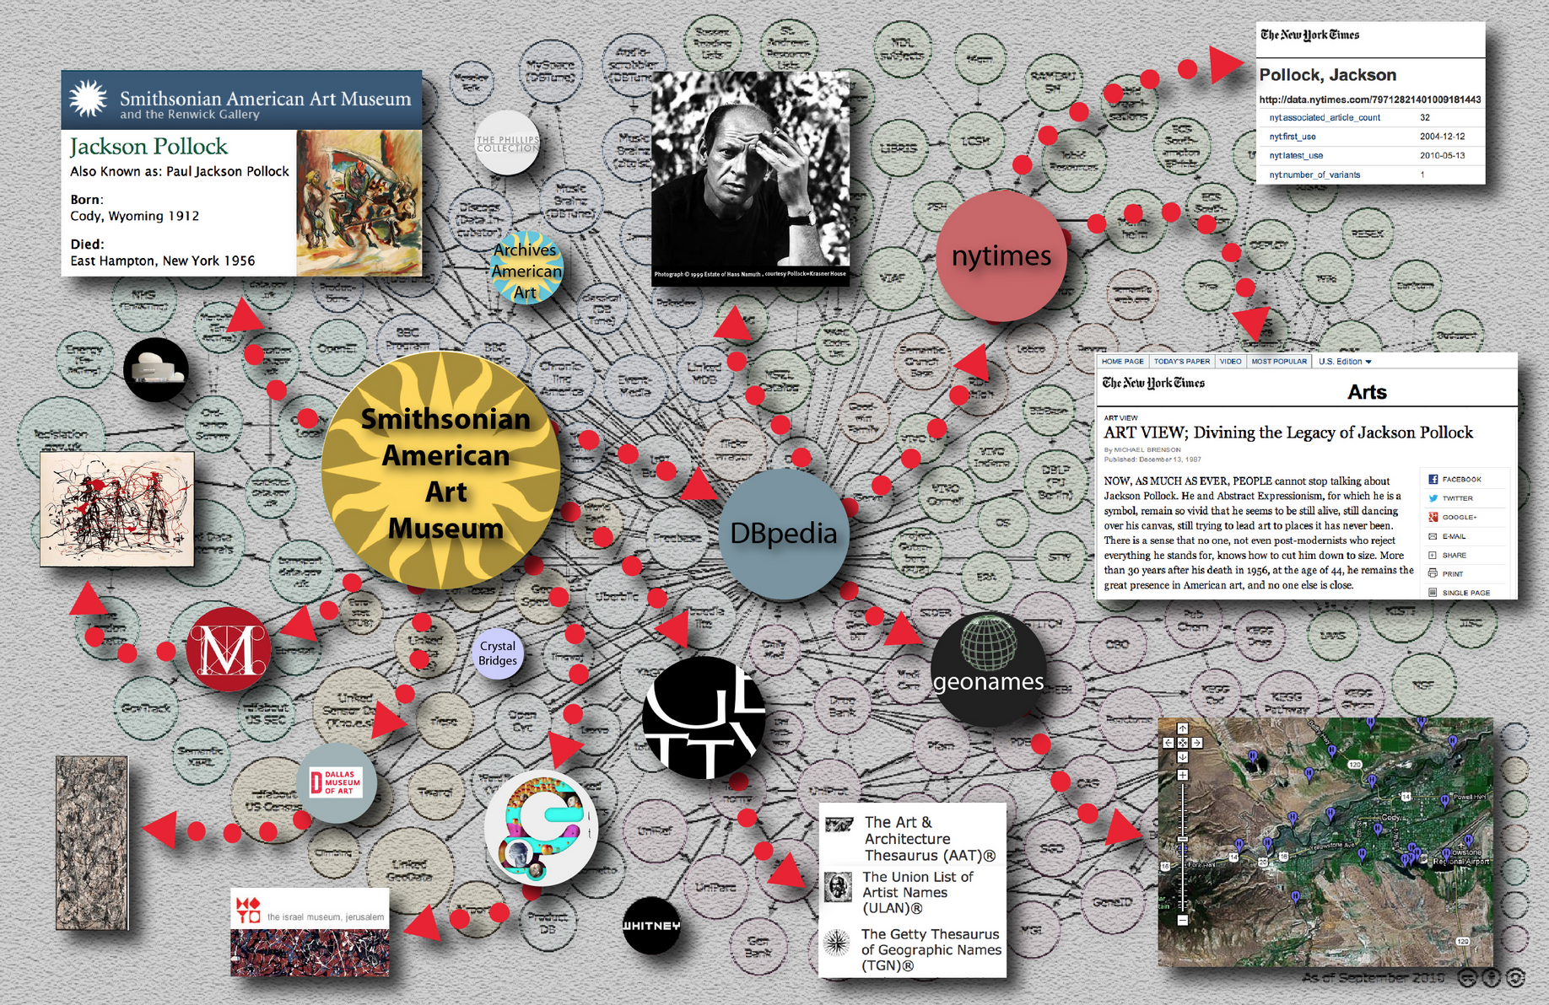
Smithsonian American Art Museum
Used Karma to convert data of 44000 museum objects to Linked Open Data
Modeled according to Europeana Data Model (EDM)
Linked the generated RDF to DBPedia, ULAN, NY Times Linked Data
News: USC press, Viterbi
Video
Notes:
linked to DBpedia, the Getty Union List of Artist Names (ULAN)® and the NY Times Linked Data

Slide 105
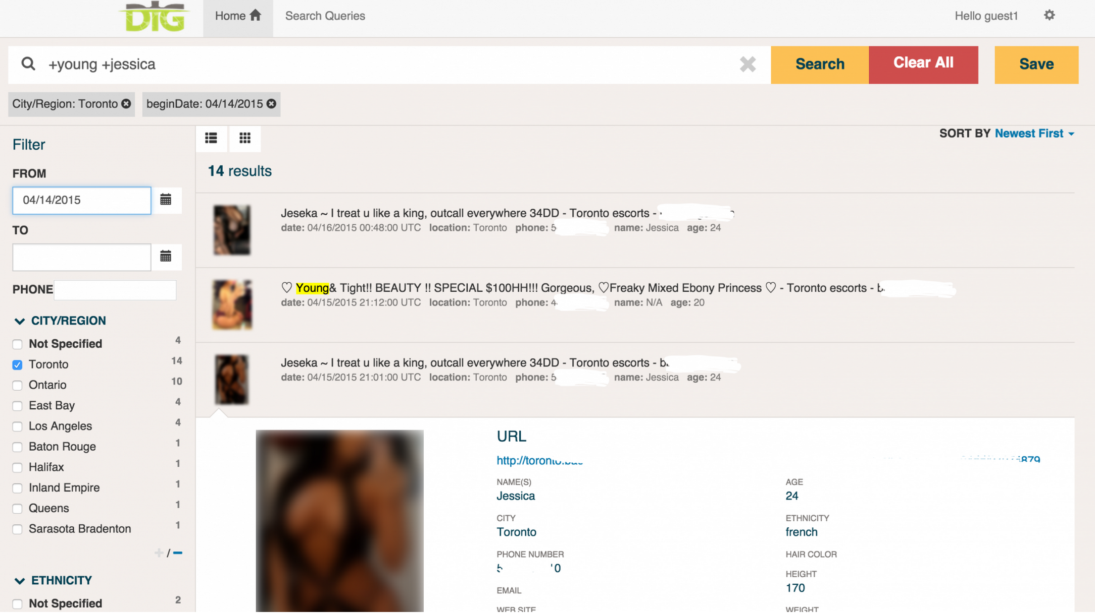
DIG
DIG: Domain-specific Insight Graphs
Building and using knowledge graphs to combat human trafficking
Used Karma to map extracted data and structured sources to shared domain ontology
News: Forbes, Wired.co.uk
Notes:
linked to DBpedia, the Getty Union List of Artist Names (ULAN)® and the NY Times Linked Data

Slide 106
Demo

Slide 107
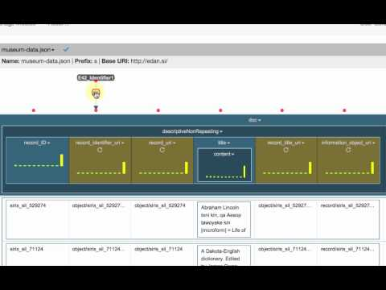
Using Karma to map museum data to the CIDOC CRM ontology
Notes:
https://www.youtube.com/watch?v=h3_yiBhAJIc

Slide 108
Links
http://usc-isi-i2.github.io/karma/
@KarmaSemWeb

Slide 109
Backup Slides

Slide 110
Related Work
Schema matching
Finds correspondence between elements of the source and target schemas
Example: iMAP [Dhamankar et al., 2004]
Schema mapping
Generate declarative mappings expressible as queries in SQL or Datalog
Example: Clio [Fagin et al., 2009]
Mapping databases and spreadsheets to ontologies
Mapping languages: D2R [Bizer, 2003], D2RQ [Bizer and Seaborne, 2004], R2RML [Das et al., 2012]
Tools: RDOTE [Vavliakis et al., 2010], RDF123 [Han et al., 2008], XLWrap [Langegger and Woß, 2009]
String similarity between column names and ontology terms [Polfliet and Ichise, 2010]
Understand semantics of Web tables
Use column headers and cell values to find the labels and relations from a database of labels and relations populated from the Web [Wang et al., 2012] [Limaye et al., 2010] [Venetis et al., 2011]
Notes:
An et al. [An et al., 2007] generate declarative mapping expressions between two tables with different schemas starting from element correspondences. They create a graph from the conceptual model (CM) of each schema and then suggest plausible mappings by exploring low-cost Steiner trees that connect those nodes in the CM graph that have attributes participating in element correspondences.
Known: Table 1, CM graph 1, marked nodes (nodes in CM1 corresponding to columns), s-tree1: a semantic tree that expresses the correct semantic of Table1 by connecting its marked nodes in CM1
Known: Table 2, CM graph 2, marked nodes (nodes in CM2 corresponding to columns), s-tree2: a semantic tree that expresses the correct semantic of Table2 by connecting its marked nodes in CM2
Goal: Find a mapping from Table1 to Table2 (a subgraph of CM1, called CSG1, to a subgraph of CM2, called CSG2
Method: If CSG2 is known (e.g., it is the s-tree2), find the Steiner tree in CM1 connecting marked nodes, preferring the edges from s-tree1
Strong assumption: we know semantic of each table (s-trees)
Use-case example: Table 1 has 10 columns with a large s-tree, and table 2 has only 3 columns. This approach finds a minimal tree in CM1 (maximum overlap with s-tree1) that connects the marked nodes of table1 corresponding to the marked nodes of table2.

Slide 111
Related Work
Exploit Linked Open Data (LOD)
Link the values to the entities in LOD to find the types of the values and their relationships [Muoz et al., 2013] [Mulwad et al., 2013]
Semantic annotation of Web services
Languages: SAWSDL [Farrell and Lausen, 2007]
Tools: SWEET [Maleshkova et al., 2009]
Annotate input and output parameters [Heß et al., 2003] [Lerman et al., 2006] [Saquicela e al., 2011]
Learn Semantic Definitions of Online Information Sources [Carman, Knoblock, 2007]
Learns LAV rules from known sources
Only learns descriptions that are conjunctive combinations of known descriptions
Extract schema-level patterns (SLPs, length one) from LOD [Schaible et al., 2016]
E.g., ({Person,Player},{knows},{Person,Coach})

